Slide 1
Smart(er) TV Data for Measurement
CIMM Compilation of Presentation Slides and Project Artifacts
Notes:
This document is a compilation and representation of the research, opinions, and recommendations that came out of the Smart(er) TV Data for Measurement initiative. The primary research was completed in the second quarter of 2023 and shared with various working groups, advisors and committee members through the third quarter of 2023. The presentation of this information is owned by CIMM. It represents the best efforts to accurately summarize the Smart TV data for measurement issues, opinions, and contributions that were shared by all participants. There is no claim to the completeness and correctness of technical details, though concepts and details are shared to promote education, transparency and dialog. Separate documents are available for the watermark document, and a compilation of notes for each of the solution areas, and a version of these slides presented with the notes.

Slide 2
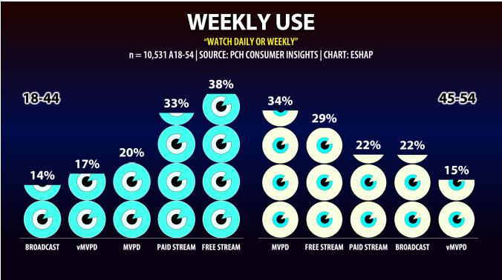
The Shift to Streaming on Smart TVs has Happened
Smart TVs 2020 vs 2023
Source: Hub Evolution of the TV set 2023 report
US Connected TV (CTV) Users, by Generation, 2020-2025 millions
 | 2020 | 2021 | 2022 | 2023 | 2024 | 2025
Gen Z (1997 – 2012) | 43.9 | 46.9 | 49.6 | 52.2 | 54.9 | 56.1
Millennial (1981 - 1996) | 56.8 | 59.2 | 60.5 | 61.5 | 62.1 | 62.6
Gen X (1965 - 1980) | 50.0 | 51.0 | 51.0 | 51.0 | 50.8 | 50.5
Baby boomer (1946 - 1964) | 34.1 | 34.5 | 33.9 | 33.1 | 32.4 | 31.6
Note: Individuals who use the internet through a connected TV at least Once per month Source: eMarketer, Sep 2021
Notes:
Visual concepts: Fast Forward, Change, Fall, Arrived at your destination…
—-------------------
Over the past two decades, the measurement of television has been increasingly tied to the data generated by the devices that provide access to or actually display video. These have been a range of internet (or phone or cable) connected devices, such as computers, set top boxes, specialty devices like Sling and Tivo, game consoles, and even mobile phones and tablets. Some newer devices (dongles or pucks) attach to televisions and enable access to live and on demand video content through a connection to the internet. All of these devices generate user data and many of the companies provide access to this return path data for commercial purposes. Many companies use return path data to quantify content and ad exposures, and some have created measurement currency that incorporates this data.
A smart TV, also known as a connected TV, is a traditional television set with integrated Internet and interactive Web 2.0 features, which allows users to stream music and videos, browse the internet, and view photos. Smart TVs are a technological convergence of computers, televisions, and digital media players. Wikipedia
Over the past 15 years, Smart TV’s have become common. During this same time, paid tv that has been traditionally accessed through proprietary set top boxes, has been in decline. Streaming video over smart TVs and services that use the smart TV operating systems to present video have become dominant in the advertising ecosystem.
The consumer behavior has shifted to streaming over Smart TVs, and the use of device data for measurement should include this behavior. This data provides insight into less common behavior that cannot be efficiently measured by panels. However, only a few of the Smart TV manufactures (OEMs) sell behavioral data for commercial use cases, leaving a significant gap in the understanding of consumer behavior.

Slide 3
Smart TV Data is Underutilized for Measurement
OEMs are participating in measurement programs in a limited manner
Each use proprietary Automatic Content Recognition – Audio and/or Video Fingerprints – to generate measurement data
Some offer data from ad serving, streaming, and custom projects to support ad sales
Legal prudence – Opt-ins from customers
Each OEM holds a limited understanding of the household, members, and some viewing habits
Expected Bias
1.1 TV per household, with bigger brands usually in the living room
Some Smart TVs have MVPD applications that replace the traditional STB
The age of viewers that engage in CTV is younger
Nielsen’s letter to clients – smart tv data is not representative of smaller incidence behaviors
OTA viewing does not include non-broadband connected households and devices
Some popular apps prohibit measurement
Identity accuracy varies with data collection practices, matching and householding approaches
Notes:
Recommended themes for a Visual: Fractured ecosystem, Gaps in visibility, missing the whole picture
—-------------------------cdh—---------------------
Smart TV data is under utilized for measurement for a variety of reasons and as a result, it is not well-understood.
Looking at the reasons for limited participation in measurement by the OEMs, there are two primary motivations. 1. Legal prudence. Privacy laws continue to evolve, and those who sell data have worked to confirm consumer permission for the use case through opt-ins or explicit disclosures. 2. Walled-garden perspective. Some believe the value of the data is greater with strategic use, that the competitive risk of the insights is too great, or are uncertain the revenue would justify the incremental overhead.
Data collection for measurement from Smart TVs has predominantly been from a technique called automatic content recognition, or ACR. This is a technique that makes a “fingerprint,” a tiny sample of the video, as a reference and stores it in the reference library database. Then, when the video is played on the consumer’s Smart TV, the video is time stamped and sampled in a similar manner and is passed back to compare it to the reference library. If there is a match found in the library, then the description of the content or ad is attached to the timestamp, and with some additional logic the manufacturer determines what was being watched. This technique can use audio fingerprints only, video fingerprints only, or both. This technique can also be combined with others such as collecting watermarks, remote control or service changes. There are times when the matchback between the source fingerprint and the collected fingerprint are innacurate or unavailable. The challenge is that few manufacturers can afford to operate an ACR system that can identify all content and ads, and that there are technical differences between the ACR fingerprinting methodologies. This means that there are few opportunities to consolidate the operational costs across manufacturers.
Each OEM has a specific view of their devices, and for measurement purposes, have unquantified biases for what they represent. Each manufacturer has, on average, only one of the average 2.5 TVs per household. The location of the television in the household can only be inferred, and the more popular, feature-rich brands are generally in the living room. There are more sources of bias in the Smart TV device data that include the fact that some of the brands have special applications from paid tv providers (like cable operators) that serve to replace the set top box. This means the behavior is not proportionately representative. The age of the household is also much younger among Smart TV owners and users. For these and other reasons, our measurement developers and users must be cautioned. A single OEM’s data is not representative and must be combined with other data and approaches for good measurement.
There are a few other items that must be acknowledged. The smart TV data, by definition, comes back through an internet connection. However, not all televisions are connected and the data that might seem like it represents purely broadcast behavior may not be – over the air without broadband connectivity. Another issue that stems from the walled-garden business strategies from the most popular streaming services is the prohibition from measurement for native applications. This means that there can be real incongruities between measurement collection from the various OTT devices and other non-OEM collection methodologies. The final area that is worth highlighting is identity. When identity is based on IP addresses, or data is combined with other sources, there can be a substantive degradation of identity fidelity.
These issues are not non-trivial, but they can be addressed with collaboration, the use of research best practices, and data science methodologies.
TECH INSIGHT – TV OEM’s all use different methods and process and sources for creating the content library that their ACR algorithms match to. They also have different methodology and processes for ACR to capture what is presented so nothing is consistent. What matches from Samsung may not match from VIzio. Some OEMs take snapshots of content every 5-10 seconds some take snapshots several times a second. Knowing what each is doing is desired, having equivalent measures is preferable. Questions were raised whether the ACR code can be common among TV OEM’s, if a consolidated video source library could increase the breadth of coverage and provide efficiencies.

Slide 4
Use Smart TV Data with Other Sources
Smart TV data use in measurement is gaining momentum for Nielsen One and currency challengers, for activation, and for optimization use cases
Best practices
Incorporate multiple OEM brands
Use with other foundational data: Panel, STB+ACR (+streaming), Identity
However, there are concerns because the technical data collection is unique to each OEM, and there is limited knowledge of how the data and accuracy differ, and if it really matters for each measurement purpose
Notes:
Visual: Use it together or in combination, reinforcing with many layers
—-------------------------------------------------------------------------------
While there are biases that need to be addressed when using Smart TV data, the general consensus in the measurement community is that the data is extremely important and should be carefully integrated for better measurement.
OEM’s use different definitions to state their reach depending the sales opportunity or measurement purpose. CIMM members would like published standard counts, e.g. monthly numbers of TVs in use, consumers opted-in for measurement, targeted ad insertion, and TVs per HH.
More OEM participation in measurement will significantly improve the ecosystem, and the data should be a part of the whole system that includes panels, set top boxes and identity systems.
Smart TV Data suffers from the same data issues present in other industry data sources which need to be solved. These include the use of incomplete or inaccurate linear programming schedules, inconsistent ids for content and ads, and incompatible classifications of content and ads. That being said, some additional steps can be taken now to better understand how the Smart TV data should be used and to improve how it could be used, specifically.

Slide 5
The Importance of Coordination is Growing
Traditional linear and digital video business models are merging on the Smart TV
Dynamic ad insertion for distributor and OEM inventory
NEXTGEN TV/ATSC3.0 – Enables linear broadcasts feeds using Internet Protocol to engage internet-delivered services. By end of 2023, 75% of HHs will have access to ATSC3.
New technologies for measurement from the glass
Open video watermark standards
AI/ML for automated video interpretation and classification – recognizes much more than fingerprints
Approaches to protect privacy and business strategies, Cleanrooms and other cleantech
Notes:
Get more participation, Collaboration, Innovation
—------------------------------------------------------------
The importance of data that comes from directly from the Smart TVs is only going to grow. This is because the way Smart TVs capabilities are influencing the business models. With the capability to deliver addressable ads in their own inventory now enabling distributor’s inventory, the divide between linear and digital is fading. The upcoming ATSC3 broadcast standard, that is primarily enabled by Smart TVs, has the potential to generate more data and revenue opportunities for several stakeholders. Coordination across stakeholders is needed to unlock the most value.
There are a few areas on the horizon worth noting for Smart TVs. The connected devices can evolve capabilities with software updates so new approaches can be more nimble. New watermarks, and machine learning may not have to wait for a new wave of TVs to work through the purchase cycle.
TECH INSIGHT – Watermarks (audio or video) are preferable to ACR for content detection because they are definitive. However, some implementations of watermarking cannot be used simultaneously (e.g. OAR and ATSC-3 335). Therefore, agreement and alignment from content providers, distributors, and consumption devices is needed so that all exposures can be captured and reported consistently.
TECH INSIGHT – The primary driver for the collection of usage data is for the ad sales models, to shed light on audiences for Dynamic Ad Insertion. ATSC-3 drives linear activity toward digital models and seriously needs to be considered how the digital and linear commingle in the measurement ecosystem. The data casting portion of ATSC-3 enables OTA services to be reported from other devices where content can be delivered e.g. Automobiles. The continued divergence and consumption of content outside of the home and on other devices stresses the importance of Identity and accurate mapping of the devices to each household.

Slide 6
Project Objective
Smart TV data is a vital input for measurement solutions as it provides a view of traditional linear (decreasing) and OTT viewing and activities (increasing,) has national representation, and scale of data to support advance buying and measurement insights.
This project’s objective is to assess the various options for enhancing the value of Smart TV data, identifying a range of practical initiatives that could materially improve the use of the data for measurement purposes and stand a reasonable prospect of being supported by a critical mass of industry stakeholders.
Notes:
Smart TV data is a vital input for media measurement solutions as it provides a view of traditional television whose viewing is decreasing and newer over the top (OTT) viewing and activities whose is viewing is increasing, has national representation, and scale of data to support advance buying and measurement insights.
This project’s objective is to assess the various options for enhancing the value of Smart TV data, identifying a range of practical initiatives that could materially improve the use of the data for measurement purposes and stand a reasonable prospect of being supported by a critical mass of industry stakeholders.

Slide 7
CIMM Smart(er)TV Phases
Identify Project Steering Committee (PSC)
Recruit stakeholders
Build questionnaires
Schedule interviews
CIMM stakeholder interviews with Agencies, Programmers, and Measurement Cos
CIMM PSC summary presentation and feedback session
Technical interviews and solution development with OEMs and vendors
CIMM PSC summary of potential solutions and feedback session
Follow-up interviews and solution refinement
Complete the evaluation framework
CIMM PSC summary of solutions and feedback session
Integrate PSC feedback
Present to CIMM SC
Integrate SC feedback
CIMM member presentation and paper
Kick-off
Hypotheses Development
Solutions Development
Conclusions
Recommendation
Review issues and current initiative with expert advisors
Interview stakeholders across the advertising industry to gather current practices and opportunities for improvement
Conduct iterative feedback sessions with committees to identify the most feasible projects with the highest potential impact
Publish list of projects, insights and recommendations
Notes:
This program was designed to take a flashlight to the data collection by and utilization of Smart TV data for measurement purposes. It followed an iterative process of discovery, feedback, re-evaluation, and socialization of the insights and recommendations. The goal is for CIMM teams or individual companies to further develop the ideas and a few of the solutions.

Slide 8
It Takes a Village: Credits and Appreciation
Adam Gerber, Head of Client Development, Advertising, Netflix
Brian West, SVP, Data & Measurement Strategy, NBCU
Helen Katz, EVP Research, Publicis Media
Albert Lau, Senior Director, Media Analytics and Marketplace Intelligence, OMG
Howard Shimmel, President, Janus Strategy & Insights
Jonathan Steuer, CEO Anonymous Media Research
Tom Morgan, Principal, MediaD.tv
Bill Harvey, Bill Harvey Consulting
Caroline Horner, Lift Analytics
Myles Parker, Consultant
Jon Watts, Managing Director, CIMM
Tameka Kee, Deputy Managing Director, CIMM
India Fordham, Executive Assistant, ARF
Project Steering Committee
Technical Advisors
Project Leads
CIMM
Notes:
Stewardship of this initiative was provided by the CIMM Project Steering Committee which was drafted to represent the major buy-side and sell-side stakeholders, tenured technical advisors, recent practitioners, and CIMM.

Slide 9
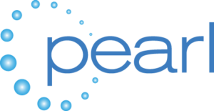
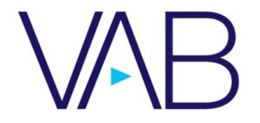
Notes:
Stakeholder groupings. See if you can draw faint lines around the groups
Many companies graciously volunteered their time to discuss the issues, ideas, and opportunities to evolve measurement from Smart TVs. Overall, there were over 44 interviews and numerous feedback sessions among CIMM members, non-CIMM members and associations. The interviewees were selected to provide the perspectives of the Buyers, Sellers, Smart TV Makers, Measurement Companies, Technical Specialists, and Associations. This group is also referred to as the stakeholders. The interviews covered specific topics and were tailored to the specific company and specialty of the executives who sat for the session – some were more technical, some more strategic. A sample guide is included in the appendix of the final document.

Slide 10
What CIMM Members Want from Smart TV Data
Buyers
1
Interoperability with optionality
Sellers
2
Access to more data
Smart TV Makers
3
Transparency
Measurement Companies
4
Industry coordination
5
Return on incremental effort
“What’s in it for me?”
Technical Specialists
Associations
Notes:
Visuals: Quote bubbles?
—----------------cdh—---------------------------------------------------
Most of the 44 interviews were an hour long, and participants passionately considered many topics. Looking back over all of the comments, five themes were the strongest. 1. Smart TV data must be made to be interoperable in the industry as long as the advances allow for optionality. Smart TV data should not devolve to the least common denominator. It must move forward. 2. Everyone wants access to more data which is two-fold – more OEMs providing data for measurement and for more types of data, not just a limited collection of the ACR libraries. The additional types of data pointed at included ad serving, watermarks, in-stream data, channel change, HDMI inputs, volume/mute, navigation and search. 3. Many stakeholders want to get more transparency and validation of the methods that are used to collect the data. There is an opportunity to increase trust and acceptance of the data, and increase the perceived value of measurement that includes data from multiple OEMs. 4. The stakeholders want to see more follow-through on the ideas. Many interoperability issues and solutions were identified over a decade ago and there is a level of frustration and complacency due to the lack of progress. 5. If we are asking any stakeholder to do something different, there must be a return on the incremental effort. While not a very attractive statement, the most common and frank exchange was “What is in it for me?”, aka the “WIIFM,” sounds like whiff-em. It is critical to work with the OEMs to ensure that incremental efforts for measurement do not impact existing revenue models. Ideally, more participation in measurement will give content providers and OEM’s better inventory optimization and allow them to take new business. Buyers will likely need to tie investment to measurement requirements. Everyone agrees there needs to be some advantage ($$) to making changes.

Slide 11
Executive Summary
“Who” saw what, when, where can be efficiently aggregated and integrated across the fragmented Smart TV media ecosystem if a common chain of identities are established and shared
Watermarks
Metadata
UserID (D-P-HH) – ContentID – AdID – Timestamp – ServiceID – DistributorID– InvOwnerID
IDs
Serviced with accessible universal IDs, open metadata, and open watermarks
Stakeholders seek some commonality and validations across disparate OEM data collection techniques
We need to build business models and foster technical solutions that support the contribution of more device data for measurement
Continue to address identity and privacy issues
Build best practices for the householding (HH) and personification (P) of device (D) data
Build legal framework for the use of device data for measurement and targeted ad supported content
HH₁
D_{n}
P_{n}
Notes:
Images. Collect, Gather together, Close the gap, Sutures, Bridges…?
—---------------------------cdh—---------------------------------------------
Interoperability across a fragmented ecosystem can best be addressed if each party can work with common IDs. These would be a set of IDs that work together to define an impression and that can be reasonably be accessed by any qualified stakeholder. The universal IDs serve as an anchor for the open watermarks and open metadata, and can provide basic universal bridges to proprietary, higher value data. The IDs cover the user (which would be a deviceID, a personID, and/or a householdID), a contentID (such as EIDR), an adID (such as Ad-ID), a disrtibutorID (perhaps EIDR’s?), and an inventory owner ID. The inventory owner ID becomes important in the addressable realm and the alignment of the measurement with the addressable requirements offers a great WIIFM for the industry to coalesce around one common set of IDs. The open metadata concept would ensure that a basic set of data could be established for aggregation across the industry operating systems. Open watermarks represent the most critical discussion for our industry to coordinate today. There are multiple initiatives that are considering incomplete requirements. We need to ensure that each revenue-based watermark initiative results in compatible data for activation and measurement.
Stakeholders have asked to establish a set of common terminology, metric definitions, and to establish a testing environment to validate or learn how to calibrate measures across OEMs.
The biggest blocker for the syndication of data among OEMs is a clear financial benefit. Whether the data unlocks more ad spend, the activation of more addressable inventory, or direct data for revenue, CIMM members need to build that case with the stakeholders. Some CIMM members wondered whether the approach would be as an incentive (like a higher CPM) or a requirement (would hold back business without broader data participation).
The other major focus for the improvement of Smart TV data must be around better identity management that bridges households-devices-people. As there are CIMM programs already addressing identity and privacy, this area of solutions was not prioritized, though a few recommendations do surface in the deeper details.
—-----------------mhp—------------------------

Slide 12
Overview (link to written document)
1. The best short-term impact will be from driving foundational interoperability, with overlap
1.1 Common terminology for published descriptive statistics
1.2 Definitions of common metrics
1.3 Cross-platform technical standards, including watermarks (1.3.1)
1.4 Disclosure of methodology and quality — FPs may not be efficient for larger role in measurement
1.5 Cross-platform program and ad IDs and taxonomies for the categories of content and ads
1.6 Services or instruments that can support access to common libraries for content and ads, and schedules
1.7 Identity graph system and householding
1.8 Cross OEM test lab
2. The longer-term and greatest impact will be to draw more data into use for measurement
2.1 Additional types of data collection
2.2 Change in app permissions
2.3 Subpanel
2.4 ATSC3
2.5 Revenue – Opportunities and buy-side incentives
2.6 Cleantech programs (or below?)
3. Measurement evolution can be accelerated with consistent coordination by CIMM
3.1 Education to align the industry on measurement issues
3.2 Cross association coordination
3.3 Project administration and commitments
3.4 Cleantech programs
3.5 Perspective on privacy
Notes:
Overall, about 20 solution areas were identified and put to vote on perceived value and achievability. The full list and details are included toward the end of this document.

Slide 13
High Value, Achievable
High Value, Challenging
Notes:
The results of the voting buoyed universal watermarks, revenue models, identity, standards, and testing

Slide 14
Core Recommended Projects
Notes:
These are the six core recommended projects. Out of the core solutions, there appeared to be some dependencies and sequencing in order for the value to be recognized. Therefore, they are presented in a specific order. A. Cross industry consensus on watermarks. B. Cross OEM discussion group C. Operational binding of IDs to the ads D. Automated schedules and metadata generation E. A sub panel (list of HHs) for which all OEMs contribute device data. F. Independent device test lab. Each project has more detail on a separate slide that follows.

Slide 15
A – Open Watermark Consensus
Video and Audio standards
Content ID’s (EIDR / ECID or custom like IRIS). Enhanced Content ID
Advertisement ID’s (AD-ID / UCID). Universal Creative ID
Distributor ID’s (EIDR ServiceID / other)
Programmers to insert final IDs defined by EIDR registry mirror, Distributor IDs using EIDR ServiceID, Advocate for EIDR/AD-ID
Facilitate discussions with OEM to support WM resolution and information distribution
Pearl/ATSC
IAB
NAB
ER, IRIS.TV
SMPTE
OEMs
ANA/Ad-ID
EIDR
Notes:
—--------------------cdh—----------------------------------
It is not a surprising conclusion to recommend the adoption of standard technology and cross functional operational approaches to heal the extreme fragmentation of media and advertising delivery. CIMM has been working this problem for nearly two decades, and the industry has had some success establishing some IDs, Ad-ID and EIDR, and getting them partially into the operational ecosystem. The ATSC3 standard was adopted by the Consumer Electronics Association (OEM’s association) which defines how these IDs can be transmitted by broadcasters and processed on smart TVs.
However, the industry has not uniformly implemented the IDs or services, most likely because there is no perceived revenue associated with measurement and interoperability. Given this perspective, we recommend that the measurement requirements be aligned with the addressable ad insertion requirements, and work to get a more universal view of addressable requirements across the ecosystem. We believe the universal approach is the watermark, which could definitely identify content, ads, and support traditional and dynamic ad insertion across the delivery ecosystem.
We recommend convening a cross industry summit to review the handful of initiatives and work to assemble the universal requirements and recommendations for the implementation of the watermarks across all devices and major value chain operations.
Later in this document there is a link to the watermark reference paper. This is a summary of various watermarks (and ACR fingerprinting) and technical pros and cons that several companies contributed to.

Slide 16
B - OEM Alignment
Facilitate cross OEM discussions for, trade group representatives included as needed e.g. ATSC-3 & revenue model development
Alignment on ACR / FP methodology
Sampling areas and frequency
Match database & source (unified source for all)
WM extraction and reporting structure
Alignment on UE’s published monthly
Sets sold or online
Sets opted in for ACR
Sets available for FAST insertion
Sets available for Dynamic/addressable
Sets in usage reporting sample (with identity)
Others…
Legal perspective on watermarks used for metrics collection.
ATSC-3 adoption
Define and propose revenue models to support data sharing
Notes:
—-----------------------cdh—--------------------
The second non-surprising recommendation is that there would be a great advantage to the industry if the smart TV manufacturers, and in particular, those who are tied to the advertising revenue models for measurement, addressability, and advertising research, routinely gathered to discuss ways to collaborate and accelerate the revenue-producing programs. This is because each OEM represents only a sliver of the homes, some media consumption behaviors, and a subset of advertising inventory. The advertising engine runs more efficiently if it can operate together. OEMs should be able to make more money if they create a universal backbone for ad delivery. The watermark standards are only one of these topics. Several of the following core projects presume that the OEMs can or would adopt some commonality over time.

Slide 17
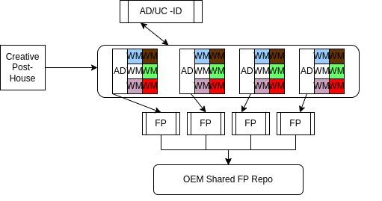
C - Binding Identifiers to the Advertisements
Operational clearinghouse for uniform processing and trafficking of linear and digital ads with multiple watermarks and the making of fingerprints
Notes:
—----------------cdh—--------------------
Most of the recommendations identified in this initiative are opportunities for collaboration. This is a little more tactical in nature. In the current workflow, Extreme Reach acts as the dominant facilitator of (ad) creative trafficking in the US. They receive an ad from the post production house or agency, and they process the ad, traffic it to the various systems and in some cases provide more reporting services. As part of the processing, Extreme Reach inserts the required watermarks and attaches the detailed IDs to the creative. The recommendation is to require agreed to IDs and additional services that could more efficiently support the measurement ecosystem. For instance, this step could create a universal ad library, and have a universal process to create the measurement fingerprints and to have those fingerprints adorned with the correct Ad-ID. Approved industry providers would be able to use the FP library for greater coverage and accuracy of ad reporting. While the idea is to centralize the process, this could be achieved with any provider, or perhaps even attached to Ad-ID services. The goal is to drive interoperability and streamline accurate ad identification across all measurement and ad delivery.

Slide 18
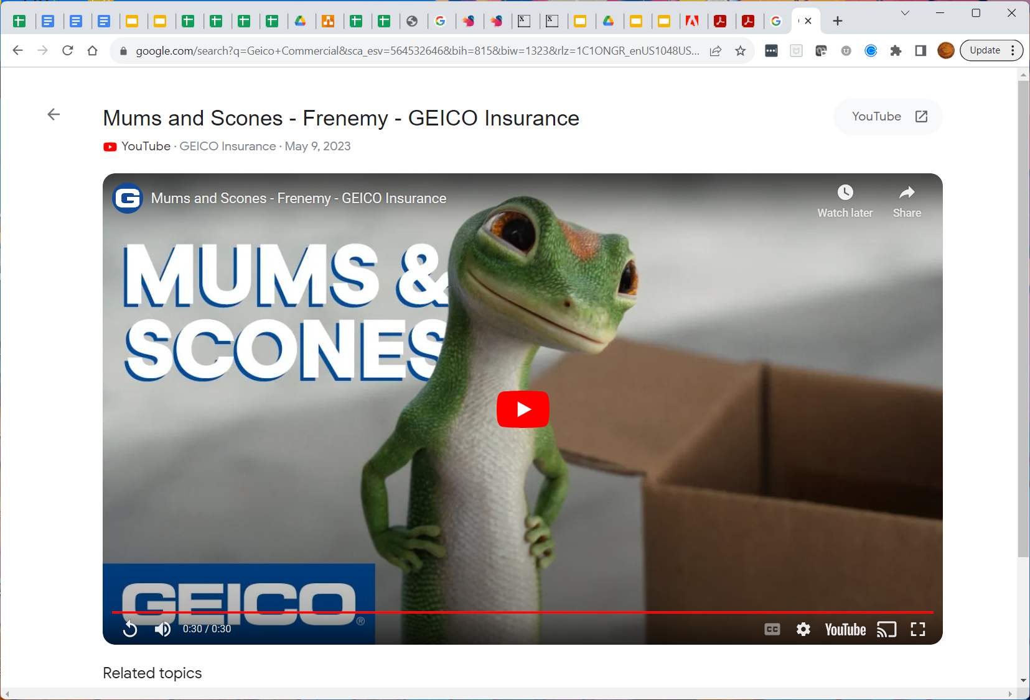
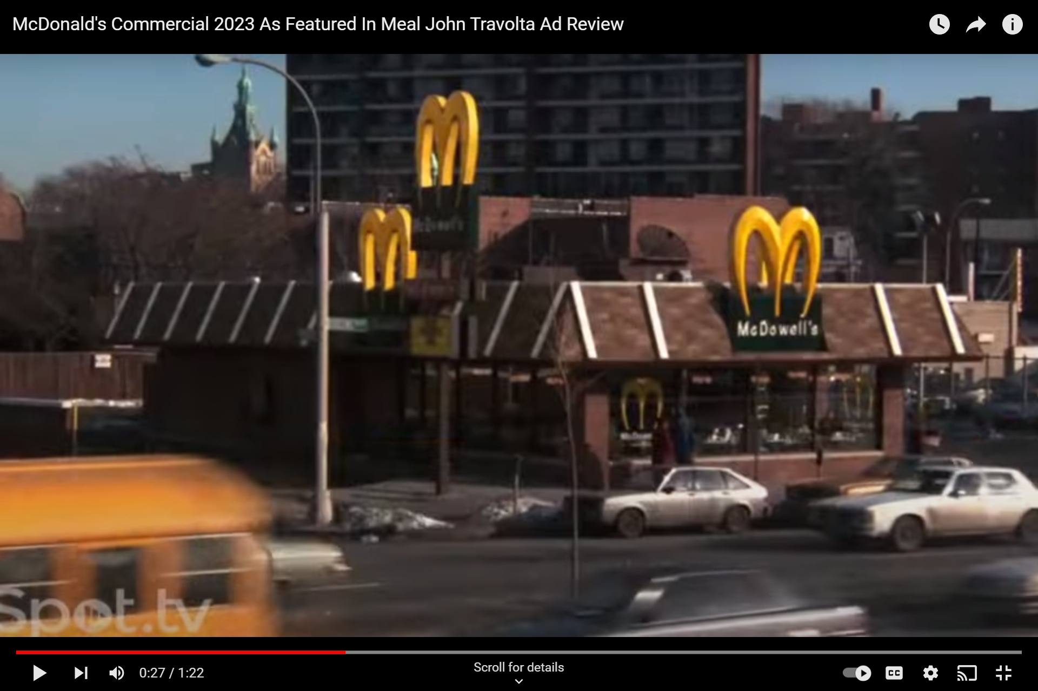
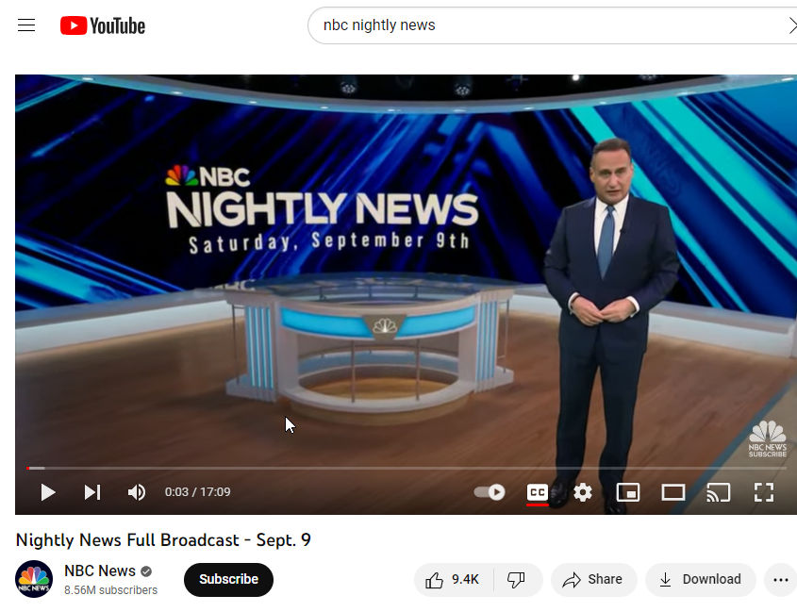
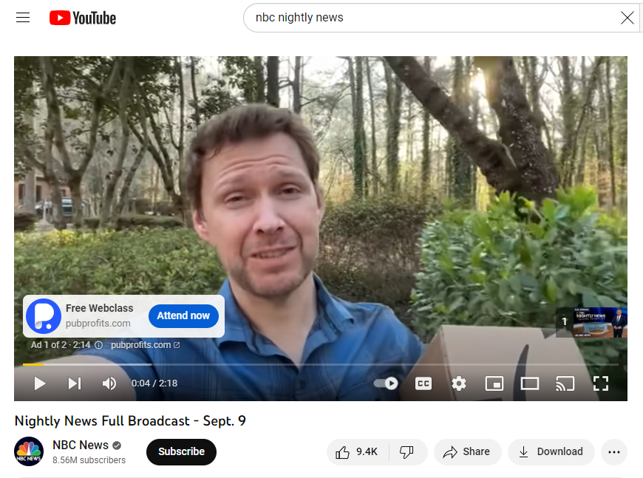
D - Open-source Metadata Using AI
Black screen transition
Start timestamp
Program identification
Algorithms
Rules
Schedules
Black screen transition
Start timestamp
Ad identification
Channel Feed
Black screen transition
Start timestamp
Ad Catalog
Program Catalog
Ad identification
Black screen transition
Start timestamp
VOD Robot
Program identification
Notes:
—------------------------cdh—--------------------------------
Several of the issues with metadata that were identified by stakeholders could be addressed by replacing traditional approaches to metadata with AI/ML techniques. Comprehensive and accurate asrun schedules are challenging to secure for a variety of reasons – local variations, distributor variations, and even broadcast variations for live events, emergencies, mirror feeds and changes in the ads. The cost and access for some are purposefully prohibitive. The inability for everyone to use basic universal content classification prevents interoperability, injects inaccuracy and costs into the ecosystem.
There are two traditional ways for companies to get the schedules. They can get the national schedules directly from the programmers, or they can purchase the schedules from a number of service providers. The service providers set up monitoring stations (with techniques such as watermarks, fingerprints, or manual assignment) or contract a constant video feed and make schedules from that. Recently, companies have established machine learning algorithms and operations to build schedules, though no system is providing comprehensive and highly accurate schedules for local and smaller networks. Companies that specialize in tracking on demand video services automate traditional crawling and scraping techniques to build up the catalog of available content by provider. Even more recently, companies are pulling descriptive data directly from the stream or video screen.
If a singular source of comprehensive video is available, such as from CCR Media, AI techniques that recognize the interstitial black screens could automate the generation of accurate timestamp schedules for any linear delivery. Additional AI techniques can be trained to identify the content and retrieve the EIDR ID, and even identify the ads and to retrieve the Ad-ID. Rules to assign classifications, such as live, sporting event, content ratings, actors, etc can be universally agreed to and made as an open classification standard, or can fuel a service that can assign and provide a look up service. Similarly, algorithms that can assign ads to brands, product categories, and owners can be automated, or retrieve and integrate a taxonomy from another system.
We recommend that the CIMM content and ad working groups develop an open set of classification rules and perhaps fund a proof of concept from a willing company.
Agree to the required format and classification logic for content and ads
Develop schedules from on-air video feeds using AI to identify the timestamps, content, commercial pods, commercial positions, and creative.
Match to registries for ads and content
Generate the taxonomies using AI to classify the asset from agreed logic (assign sports, content rating, genre and sub-genre, etc.)
Consider working with Ad-ID and EIDR or other organizations to establish a non-profit management of the metadata or just the logic that fuels the metadata.

Slide 19
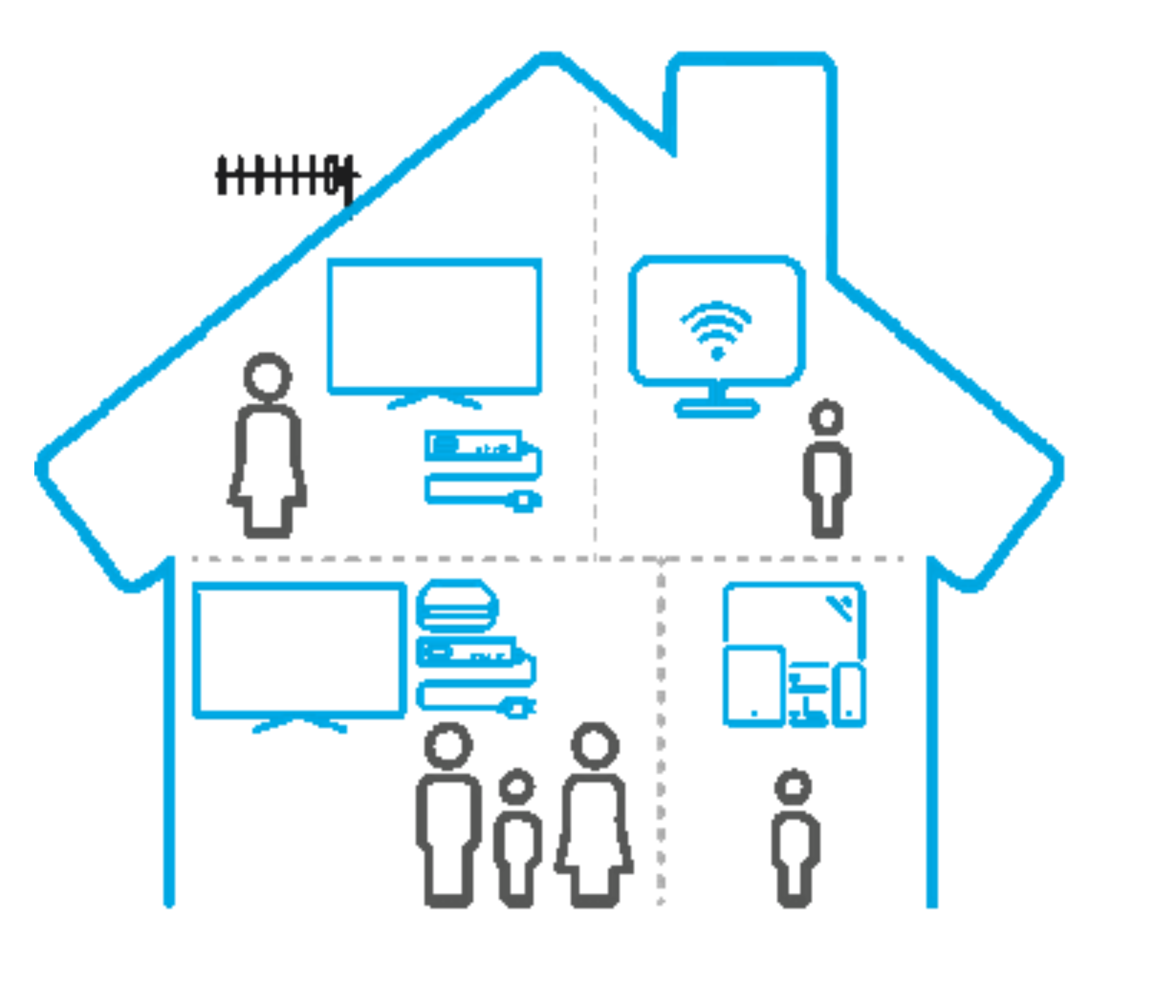
F - Representative Sub Panel
Establish a representative subset of households (HH)
OEMs supply data from all devices for each of the identified HHs
Report and manage panel monthly
Revenue stream for reporting
Establish HH Set
OEMs Forward Activity
Independent Reporting Entity
Notes:
—--------------------cdh—-------------------
There is a clear desire from the advertising community to understand the total reach and frequency of etc. ad delivery, ideally to a person. This has been elusive because no singular owner of data can measure all occurrences. The industry has struggled to design a measurement that spans the walled gardens by publisher, service, device, and application. While it might be challenging to convince OEMs to provide insight to all of their consumers, perhaps there is a program that could gather the data from each OEM for a specific list (subpanel) of households. The panel would be revenue generating, managed to certain compliance requirements, and equally open to qualified customers. The goal would be to fuel models for deduplicated reach, and managed by an independent group. While the many details would need to be more fully developed, it is possible that groups like the JIC or companies like Conviva could also or alternatively forward the activity for the listed households. If there is a general measurement panel established by the VAB/ANA/TVB or other, the OEM subpanel would ideally include the list households.

Slide 20
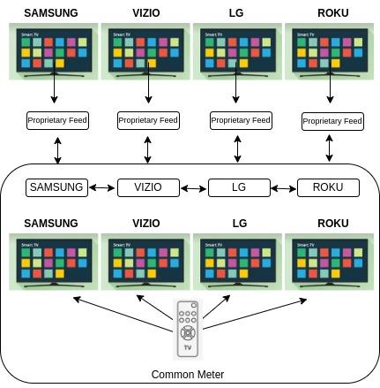
G - Device Test Lab
Establish an independent lab with the most prevalent reporting device from each OEM with the same access provider to validate reported activity data and identify if any differences between OEMs merit methodologic adjustments
Notes:
The last core program in these recommendations is the cross-OEM device test lab. The goals is to address the questions that stakeholders have about the similarity of the data generated by the different OEMs and techniques. The proposal is to develop an independent test lab that controls the generation of identical events, compares the data from the common meter and compares them to the OEM provided device data. The lab shares the individual comparison with the OEM, and advises on general benchmarks and variations across the whole set without publicly attributing specifics to each OEM, similar to other CIMM initiatives.

Slide 21
Idealized Roadmap
2023
2022
2025
Q4
Q1
Q2
Q3
Q4
Q1
IDs Watermarks
Cross Assn ID
“Camp David”
Member Company Audits
Watermark Tests
Open Metadata
Proposal Requests
Metadata Development
Metadata Testing
Metadata Integration Program
Definitions
Test Lab Proposal
Test Lab
VAB MITF and JIC Alignment
Standards
OEM Alignment Paper
OEM Proposal
Proposal Request
Unified Ad Operations for WMs + FPs + IDs
Revenue Model Ideation
Subpanel Project Requirement/ Design
Proposal Requests
Project Test
Data Pool
XP Insights
More Data
ATSC3 Summit
In-App Permit
Notes:
This idealized roadmap suggests a sequence of activities and swim lanes, starting with the highest priority in the upper left corner. There are some soft suggestions on what might happen in the subsequent quarters, as most of the projects begin with the drafting or assignment of a working group. These groups would craft the substantive project plans.
It bears repeating, a set of universal IDs is the core to improving measurement and advertising. These IDs are the foundation of watermarks and the bridge for metadata and addressable ad revenue. This CIMM Smart(er) TV Data initiative would be successful if the diverging programs and requirements could be considered and aligned to establish a universal approach for watermarks and IDs. This would fix the dominant source of the inaccurate or incomplete data that flows through the OEMs and into measurement and reporting.
The other programs, such as the open metadata and standards are relatively straight forward in the roadmap. They start with a definition phase and move to tactical considerations.
Three programs in the roadmap are not described in the Core 6. This is because they are are more about building ideas and agreements. How can the revenue WIIFM be developed for the contribution of data from the OEMs for measurement, whether that be for the subpanel, nurturing of the ATSC3 data pools, and removing the app measurement prohibitions so that the gaps in measurement don’t skew the perceived value of content or advertising exposure?

Slide 22
Advisors’ Perspectives
Bill Harvey
Tom Morgan
Jonathan Steuer
Congratulations on creating a whole new method for making forward progress on industry collaborations which have never been possible before. I think of it as babystepping or bitesizing. You have demonstrated a method for breaking huge, complex and apparently insoluble programs into tiny chunks that can be investigated one at a time, without parties feeling that they are risking anything that ought not be risked.
By offering the baby steps of Camp David, OEM Test Lab, Representative Subpanel, Fingerprinting At Birth (e.g. Extreme Reach), one would expect that the OEMs and all other parties will agree to take such steps, on an exploratory cautious basis, and if this demonstrates that benefits can be achieved by all parties rather easily, it should slowly gain momentum and move itself eventually faster. But even if it stays slow forever but keeps making crawling progress that is infinitely better than the starting state.
Thank you both for this intensive and brilliant approach! This could become a major modus operandi for CIMM.
Best to all, Bill
Bill Harvey
Executive Chairman
Bill Harvey Consulting, Inc.
Early efforts in Watermarking focused entirely on CTV based linear addressable. The CIMM Team and process we went through caused a pretty extensive rethinking of the potential role of Watermarking. This focused our thinking into supporting common ad asset tracking and an open, competitive, but secure measurement process. From there we focused on the ability and need to provide interoperable addressability across all forms of TV. These two objectives are intertwined.
Based on this work I am now convinced that an open but secure watermark signaling standard can be realized and adopted across programmers, distributors and the glass. Encourage the industry to now think in terms of comprehensive Proof of Play (POP) and Universal Addressable Ready (UAR).
Advertisers need to step up and communicate what they need and how to use standard asset identity in this age of big data and more open measurement. Closed silos should not be the future of TV.
Tom Morgan
Principal
MediaD.tvJonathan Steuer
The future of TV measurement will require privacy-protective ways to combine multiple “big data” sets and to calibrate those with a panel. Efforts are currently gated by three major challenges: Broader access to more data in a privacy-protective manner, better interoperability of datasets to enable smoother and more accurate integration, and a research-grade calibration panel for calibration and benchmarking. This research digs into the gory details of mapping out the need for and paths in the direction of solving for enabling broader data access and for integrating TV data more efficiently and effectively.
One thing is clear: Technical challenges (though there are many) are not toughest problem here. Collaboration across the industry will be required to get to accurate measurement at scale. The current Tower of Babel of data formats, data business models, content and advertising identifiers, identity solutions, privacy-protective data environments and partial-solution research panels may seem to provide competitive advantage to certain providers for now. But we’re missing the forest for the trees in terms of capturing a holistic picture of media and advertising consumption — a picture increasingly relevant to both publishers and marketers as media fragmentation continues to explode. There’s plenty of room for competitive advantage and business innovation in creating and packaging content, creating and targeting clever ads, understanding media consumption behavior, and negotiating media transactions — but all should be built on a common set of comprehensive, accurate, accessible and interoperable underlying data.
Jonathan Steuer
CEO
Anonymous Media Research
Notes:
—--------------cdh—----------------
This program was approached with the idea of a flashlight. Let’s take a look into the causes of lower fidelity data that flows through the Smart TV measurement ecosystem and highlight what CIMM members could do to improve the quality for measurement. Our advisors are passionate and technical practitioners in advertising research, operational delivery, and measurement. Their guidance, introductions, and reviews helped shaped the entire program. The recommendations may be disruptive to some workflows but intend to provide paths for broad participation and coalescence.

Slide 23
Project Artifacts

Slide 24
Hypotheses and Solution Areas

Slide 25
Overview (Overview link is to the summarized notes. Individual links below jump to the specific slide for that solution set.)
1. The best short-term impact will be from driving foundational interoperability, with overlap
1.1 Common terminology for published descriptive statistics
1.2 Definitions of common metrics
1.3 Cross-platform technical standards, including watermarks (1.3.1)
1.4 Disclosure of methodology and quality — FPs may not be efficient for larger role in measurement
1.5 Cross-platform program and ad IDs and taxonomies for the categories of content and ads
1.6 Services or instruments that can support access to common libraries for content and ads, and schedules
1.7 Identity graph system and householding
1.8 Cross OEM test lab
2. The longer-term and greatest impact will be to draw more data into use for measurement
2.1 Additional types of data collection
2.2 Change in app permissions
2.3 Subpanel
2.4 ATSC3
2.5 Revenue – Opportunities and buy-side incentives
2.6 Cleantech programs (or below?)
3. Measurement evolution can be accelerated with consistent coordination by CIMM
3.1 Education to align the industry on measurement issues
3.2 Cross association coordination
3.3 Project administration and commitments
3.4 Cleantech programs
3.5 Perspective on privacy
Notes:
These are the opportunities that stakeholders suggested or commented on during the interview process. This is a list generated from the compiled notes from the interviews, and the linked overview notes do not identify the stakeholders. Overall, constituents felt the interoperability initiatives would be the easiest to address, except for the open watermark. The more impactful programs intend to increase the amount of data that is available for use in measurement. This document has already describe some of the core recommended projects, although very little time has been spent highlighting the future potential data generated using the ATSC3 standards. This program needs more attention to groom it for measurement uses. The biggest untapped potential, given all new smart tvs have this standard for the use of watermarks, fingerprints, and other measurement events for OTA and terrestrial delivery.

Slide 26
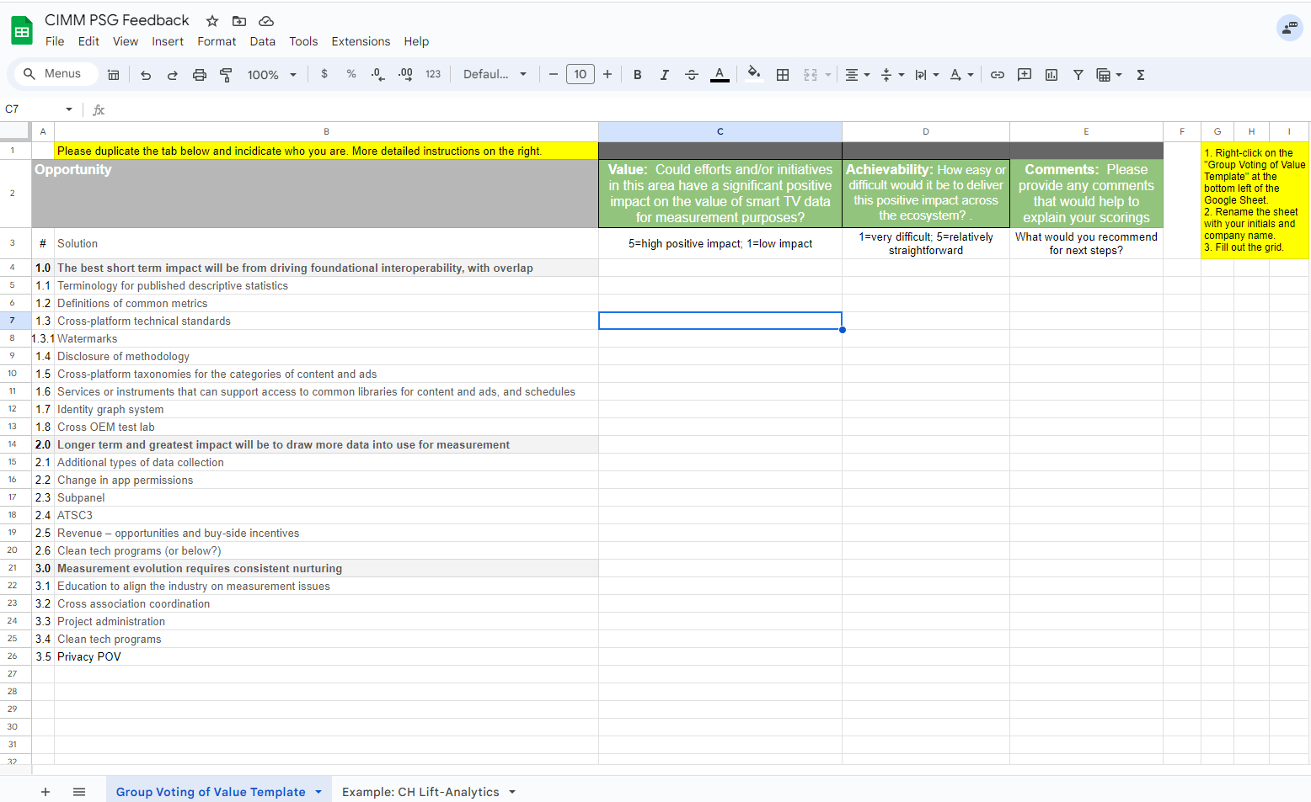
Feedback and Voting Request
After reviewing some of the potential solutions in the individual hypotheses solution slides, please place a value on the solution sets.
Please use this link to provide your feedback. Duplicate the template tab, rename it, and fill it out. CIMM Feedback Template
Some of the initiatives overlap current projects, so let’s call those out as well.
These, along with estimated viability, time and effort, will reweight the overall ranking of the opportunities.
Notes:
The design of this program was to incorporate feedback cycles with CIMM advisors. This was expanded to the CIMM working groups and a larger group of expert advisors. These individuals were asked to provide feedback for participation in these programs, and a rating of the perceived value and effort. This was one of the grids used to collect votes.

Slide 27
Eval Grid
 |  |  |  |  | Evaluation Criteria
Opportunity |  | Description | Advantages | Challenges | Effort by stakeholder | Hard Costs | Buy-in | Timing | Value | Industry Impact
# | Solution |  |  |  | H, M. L | ><$1mm, >$5mm | Limited, Broad | ><1yr, >2yrs | H, M. L | H, M. L
1.0 | The best short term impact will be from driving foundational interoperability, with overlap
1.1 | Terminology for published descriptive statistics |  |  |  | L | ~0 | Broad | Months | L, M | L
1.2 | Definitions of common metrics |  |  |  | M, L | $ | Broad | Months | M | M, L
1.3 | Cross-platform technical standards |  |  |  | H | $$ | Challenges | 1 | M | M
1.3.1 | Watermarks |  |  |  | H | $$$ | Challenges | 2+ | H | H
1.4 | Disclosure of methodology |  |  |  | M, L | $ | Limited | 1 | M | H
1.5 | Cross-platform taxonomies for the categories of content and ads |  |  |  | M | $$ | Challenges | 1 | M | M
1.6 | Services or instruments that can support access to common libraries for content and ads, and schedules |  |  |  | M | $$ | Limited | 1 | M | M
1.7 | Identity graph system |  |  |  | M, L | $$, $$$ | Challenges | 1, 2 | M | M
1.8 | Cross OEM test lab |  |  |  | M, L | $$ | Limited | 6mo | M | M
2.0 | Longer term and greatest impact will be to draw more data into use for measurement
2.1 | Additional types of data collection |  |  |  | H | $$$ | Limited | 1 | H | H
2.2 | Change in app permissions |  |  |  | M, L | $ | Limited | 6mo | H | H
2.3 | Subpanel |  |  |  | H, M | $$ | Limited | 1 | H | H
2.4 | ATSC3 |  |  |  | H, M | $$$ | Limited | 2 | H, M | M
2.5 | Revenue – opportunities and buy-side incentives |  |  |  | H | $ | TBD | 1 | H | H
2.6 | Clean tech programs (or below?) |  |  |  | M, L | $$, $$$ | Broad | 1 | H, M | M
3.0 | Measurement evolution requires consistent nurturing
3.1 | Education to align the industry on measurement issues |  |  |  | L | $ | TBD | 1, 6mo | H, M | M, L
3.2 | Cross association coordination |  |  |  | M | $ | TBD | 6mo | H | M
Notes:
This set of feedback is from the project technical advisors. They provided subjective values, but it is relevant because they are far more knowledgeable about the history of the problems and prior solutions.

Slide 28
Subjective Ranking by the Project Team and Advisors
Sorted by Impact, Viability and Time to Market
Solution | Solution Name | Viability | Time to Market | Impact3.2
3.2 | Cross association coordination | 5 | 5 | 5
3.3 | Project administration | 4 | 4 | 5
1.7 | Identity graph system | 3 | 3 | 5
2.2 | Change in app permissions | 3 | 3 | 5
2.5 | Revenue - opportunities and but-side incentives | 3 | 3 | 5
3.5 | Privacy POV | 3 | 3 | 5
2.6 | Clean tech programs (or below?) | 4 | 2 | 5
2.3 | Subpanel | 2 | 2 | 5
1.3.1 | Watermarks | 2 | 1 | 5
1.3 | Cross - platform technical standards | 3 | 3 | 4
1.6 | Services or instruments that can support access to common libraries for content and ads, and schedules | 3 | 3 | 4
2.1 | Additional types of data collection | 3 | 3 | 4
2.4 | ATSC3 | 3 | 2 | 4
3.1 | Education to align the industry on measurement issues | 5 | 4 | 3
1.2 | Definitions of common metrics | 4 | 4 | 3
1.4 | Disclosure of methodology | 4 | 4 | 3
1.5 | Cross - platform taxonomies for the categories of content and ads | 4 | 4 | 3
1.8 | Cross OEM test lab | 4 | 3 | 3
1.1 | Terminology for published descriptive statistics | 5 | 5 | 1
What can CIMM do and what should others?
Which ones are in process?
Notes:
This was the result of the expert subjective rankings.

Slide 29
Discussion Topics

Slide 30
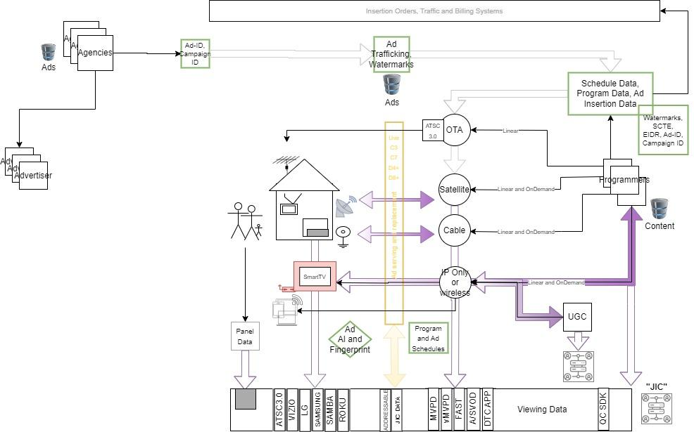
Media Ecosystem
Inaccurate, incomplete, or incompatible data passed to measurement companies affect all downstream activities
UserID (D-P-HH) – ContentID – AdID – Timestamp – Distributor or ServiceID– InvOwnerID
Notes:
At the beginning of the program we discovered that many stakeholders were not aware of how the data ecosystem fit together. So, we provided this conceptual dataflow and used the gradual build of the image to highlight areas where data quality is compromised. Given the positive response to the diagram, we believe there should be more education for our industry on how data is connected and what we can do together to fix it.

Slide 31
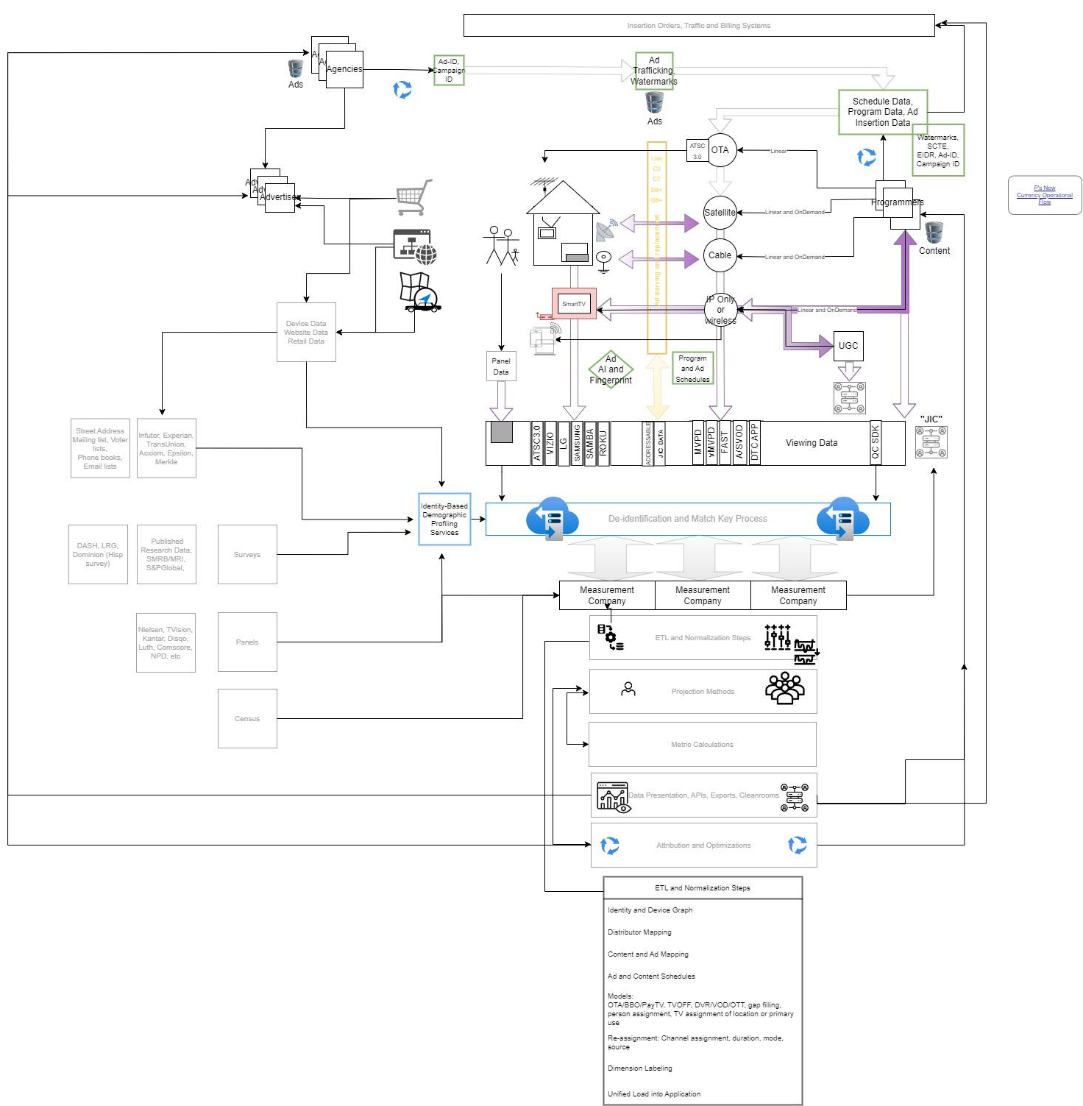
Media Ecosystem
Education → Internal audits
Standards → definitions, metrics, technical
Open watermarks
Universal IDs
Open source metadata – schedules, taxonomies, markets
Operational steps that correct data
Cross-association and standards bodies alignment
Recommendations
Notes:
This diagram adds the downstream and more inclusive perspective on how “all” of the data fits together for measurement and reporting. The emphasis is on all the stages where data quality can change, diverge, or converge. This is complex, but working and can improve.

Slide 32
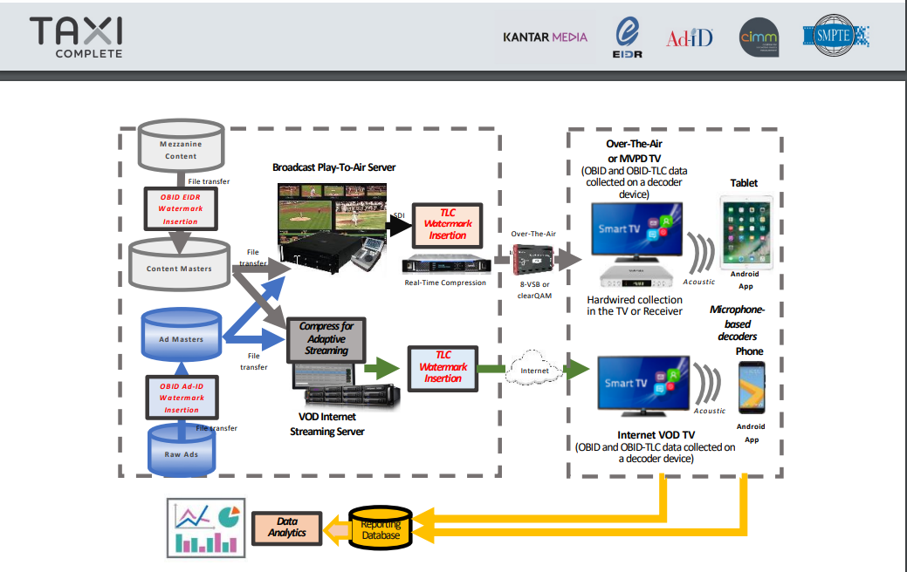
TAXI Initiative
Programmers did not want to implement another proprietary standard
Kantar feared legal repercussions from Nielsen ACR acquisitions
No WIIFM such as addressable activation
Lack of continued CIMM stewardship
Opinions about the failed adoption
TAXI Documents
E&Y Roll-out Briefing
E&Y Metadata reference doc circa 2011
Links
Notes:
—---------------cdh—------------
The anchor recommendation of this CIMM project is to revisit the failed TAXI Initiative from over ten years ago. Revisit, but not revive. The ecosystem has evolved a bit since then, and there are new considerations that could drive adoption this time. 1. Cross-device and inventory dynamic ad insertion requirements are becoming more important to unlock ad revenue 2. Open and universal watermarking standards may coexist with proprietary watermarks and fingerprints and new payload techniques might solve some prior blockers. 3. Smart TVs provide large scale reading of WMs across inventory types and ATSC3 provides the standard that can carry the watermarks. Ads can more easily be watermarked, and video content could be processed with the universal watermark by the programmer or distributor. The world may have changed just enough to try again.

Slide 33
Watermark, FP, and AI Techniques Summary
Watermarking is the superior approach for the accurate cross-platform identification of assets, but requires significant collaboration and investment for the adoption of an open and universal standard and technology. Needs to be tied to activation for adoption.
Fingerprinting will only approximate identification, and requires additional techniques or investment to improve the quality for measurement. May not be sufficient for activation.
AI/ML techniques may provide better solutions for comprehensive measurement. May not be sufficient for activation.
Operational Support for ID Registries (Content, Ads, Distributors) need to support real time transactional inquiries for digital adoption. While EIDR and AD-ID themselves may not be, some companies are standing up mirrors of these registries to support their use in their ecosystems.
Watermark and Fingerprint Paper
Notes:
EIDR - mirror used by Google and Amazon
SMPTE - Open Binding of IDs to Media

Slide 34
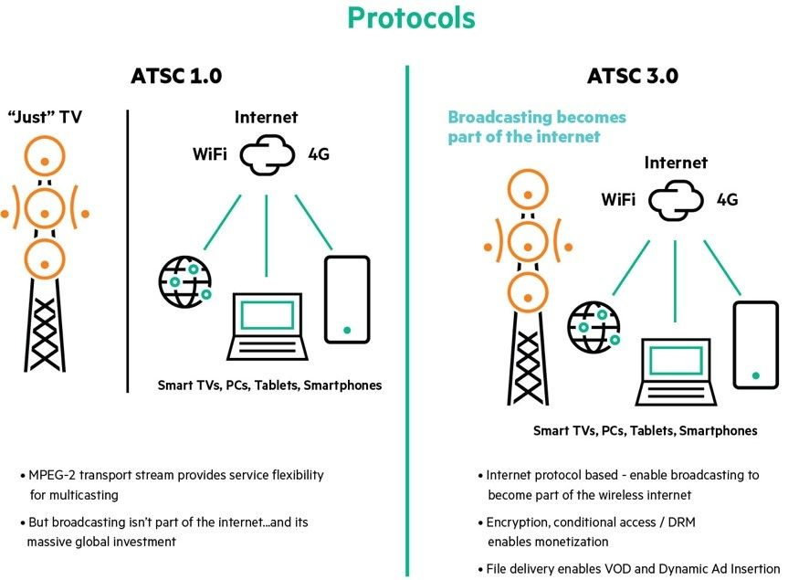
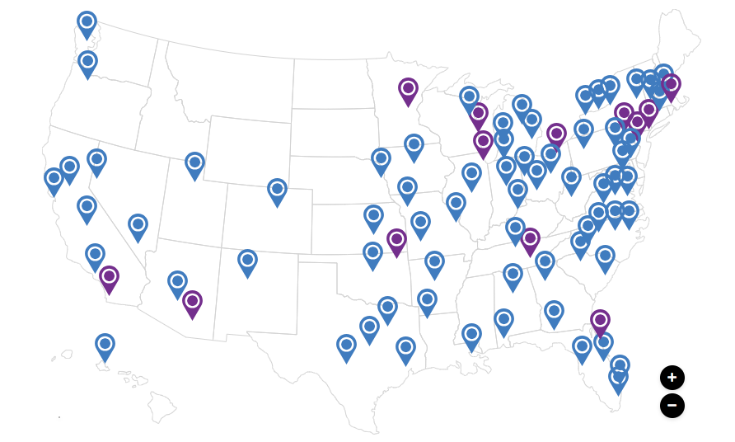
NEXTGENTV Opportunities
New data collection from broadcast, cable, MVPD
Watermarks and Internet behaviors
Different ownership of the data
Difference of opinion on potential impact
Activation incentive for new watermarks
Inconsistent implementation of standards and competing Audio/Video options
Value Prop
Data is defined in the ATSC3.0 standard
Apps collect data and send via IP
Notes:
There is limited information regarding the active footprint of each OEM and the number of households or devices that can provide any given capability. Projects like ARF’s DASH Survey does nationally quantify the penetration of smart tv brands, identify the location of the brands in the household, and whether it is used for steaming. It does not, however, quantify those that opt into measurement programs, which are ATSC3 feature-rich, and which have addressable advertising for all inventory types. As the measurement community attempts to model reach and frequency at a household or person level, the universe estimates for these capabilities are critical. For advertisers, the ability to assemble a plan that effectively combines the OEMs and the ability uniformly buy across OEMs is desired

Slide 35
OEM Estimated Coverage (Need to establish this view)
~2.3 TVs/HH, 123.5 million HHs, ~286 million TVs | Samsung | LG Ads | Vizio | Sony | TCL | Hisense | Philips | Insignia | Sanyo | Sharp | Toshiba | Other | Don't Know | Roku | Samba | Conviva
Statista Survey March 2023 | 32% | 19% | 12% | 7% | 6% | 4% | 3% | 2% | 2% | 2% | 2% | 6% | 3%
Estimated HHs | 39.52 | 23.465 | 14.82 | 8.645 | 7.41 | 4.94 | 3.705 | 2.47 | 2.47 | 2.47 | 2.47 | 7.41 | 3.705
Estimated Devices per HH | 1.8 | 1.3 | 1.5
Self Reported HHs or Devices | 72 | 30 | 22 |  |  |  |  |  |  |  |  |  |  | 70 | 3.5
Connected/Active
Matchable
Opted In for Measurement
Measurement Feed | No | Yes | Yes
ATSC 3 Footprint | Yes, #? | Yes, #? | No | Yes, #? |  | Yes, #? |  |  |  |  |  |  |  | No | NA | NA
Networks covered for content measurement
Networks covered for ad measurement
Targeted Ads
Other notables | Panel |  |  |  |  |  |  |  |  |  |  |  |  |  | ID graph

Slide 36
TV ownership by brand in the U.S as of March 2023
TV ownership by brand in the U.S. 2023
Note(s): United States April 2022 to March 2023; 18-64 year; B167 respondents; respondents who have TV in their household (Housing & household equipment , internet & devices)
Further information regarding this statistic can be found on page 8
Source(s): Statista Consumer Insights: 0997115

Slide 37
Appendix
Notes:
There is limited information regarding the active footprint of each OEM and the number of households or devices that can provide any given capability. Projects like ARF’s DASH Survey does nationally quantify the penetration of smart tv brands, identify the location of the brands in the household, and whether it is used for steaming, it does not quantify those that opt into measurement programs, which are ATSC3 feature-rich, and which have addressable advertising for all inventory types. As the measurement community attempts to model reach and frequency at a household or person level, the universe estimates for these capabilities are critical. For advertisers, the ability to uniformly buy across OEMs is desired.

Slide 38
Acronym Lookup Table
ALT-- ACRONYM LOOKUP TABLE
ACRONYM | DEFINITION | DESCRIPTION | EXAMPLE
OEM | Original Equipment Manufacturer | Smart TV manufacturer, or other Device Manufacturer | Samsung, Vizio, Hisense
MVPD | Multi Video Platform Distributor | A subscription service that provides video content from multiple programmers and distributes over multiple platforms | Charter, Comcast, Hulu Live, YouTube TV
ACR | Automatic Content Recognition | https://en.wikipedia.org/wiki/Automatic_content_recognition | Audio or Video Fingerprint Matching
WM | Watermark | Information that is injected into the content transport stream that serves to identify the content or rights associated with the asset | VEIL, ...
FP | Fingerprint | A subset of data captured from an audio or video asset that is used to identify the asset when matched to sample captured during a subsequent viewing behavior
AI/ML | Artificial Intelligence, Machine Learning | Automated computer process that uses training to identify or classify content | Convolutional Neural Networks, Optical Character Recognition, Natural Language Processing, Semantic Anlaysis, etc
Ad-ID | Advertising Identification | Proprietary ad identification (10 digit code) established by the ad owner and serviced by the company with the same name

Slide 39
Acronym Lookup Table (Cont.)
ALT-- ACRONYM LOOKUP TABLE
ACRONYM | DEFINITION | DESCRIPTION | EXAMPLE
EIDR | Entertainment Identification Registry | Proprietary content identification (code) established by the content owner and serviced by the company with the same name | EIDR
TAXI | Trackable Asset Cross-Platform Identification | A CIMM initative from 2013 that established a workflow and technology that would embedd IDs into broadcast assets | https://cimm-us.org/initiatives-2/taxi/ https://thearf-org-unified-admin.s3.amazonaws.com/CIMM/Documents/CIMM-TAXI-Rollout-Briefing-from-Ernst-Young-4.18.2013.pdf https://thearf-org-unified-admin.s3.amazonaws.com/CIMM/Documents/TX_AIP.11.pdf
AAIS | Addressable Asset Identification Standard | A workflow and set of tools to embed EIDR and Ad-IDs into assets by the distributor | TitanTV video describes how it works
DOI | Digital Object Identification | https://www.doi.org/
ECID | Extended Content Identification | IAB proposed standard to enable more sophisticated programmatic advertising | Link at IAB?
UCID | Universal Creative Identification | IAB proposed standard that can embed Ad-IDs and other IDs by using accredited registries | Link at IAB?
DASH | Digital Account Sharing | ARF Research Survey that quantifies the use of media devices and services in the home | NA

Slide 40
Acronym Lookup Table (Cont.)
ALT-- ACRONYM LOOKUP TABLE
ACRONYM | DEFINITION | DESCRIPTION | EXAMPLE
IP Address | Internet Protocol Address | [For media measurement context] This is a code that is used to identify the router that is sending and receiving information over the internet. It is sometimes used as a proxy for home address.
UGC | User Generated Content | YouTube or other social platform content that is not generally considered "premium" video | TikTok Video, "The Beast"
QC SDK | Quality Control Software Development Kit | An application that tracks requests and responses between the videoplayer and videoserver. Data is used to monitor the speed of delivery and playout. It also can store detailed measurement about every interaction. | Conviva
A/SVOD | Ad/Subscription Video Ondemand | Services that provide on demand video | Netflix
DTC | Direct to Consumer | Consumer purchases access to video content directly from the Programmer | AMC+
FAST | Free Ad Supported Streaming | OTT content services that are ad supported | Tubi
UE | Universe Estimate | A quantification of a behavior or status that represents the entire group | Census, TV Households, Brand owners

Slide 41
Acronym Lookup Table (Cont.)
ALT-- ACRONYM LOOKUP TABLE
ACRONYM | DEFINITION | DESCRIPTION | EXAMPLE
ATSC | Advanced Television Systems Commitee | An international, non-profit organization developing voluntary standards for digital television. | ATSC3 or NextGenTV, ATSC 334/335
SCTE | Society of Cable Telecomminucations Engineers | An organization within CableLabs that sets the standards for cable technologies. Standards like those used to format and embed information into the transport stream. | SCTE 35, 104,
VAB | Video Advertising Bureau | https://thevab.com/about | Association
IAB | Interactive Advertising Bureau | Parent of IAB Tech Lab https://iabtechlab.com/ | Digital Advertising Standards
ARF | Advertising Research Foundation | https://thearf.org/
ANA | Association of National Advertisers
WFA | World Federation of Advertisers
SMPTE | Society of Motion Picture Television Engineers
JIC | Joint Industry Committee
ISA | Independent Streamers Association

Slide 42
Solution Slides (Numbered and linked in the online version from the overview list)

Slide 43
Interoperability Group – 1.1
1.1 Common Terminology
Problem
Solution
Benefits by Stakeholder Group
The counts of measured devices and households reported by various licensees are confusing because they appear to be inconsistent
Publish a common set of terminology for OEMs, Measurement companies, and Sellers to use
Buy – Get the information they need to build plans; more accurate and clear definitions from “Count” companies
Sell – Get information they need to better manage inventory, create new offerings; more accurate and clear definitions from “Count” companies
Count – Levels competitive references, appropriately puts responsibility with the providers, highlights methodology choices
OEM – Levels competitive references
Support – ?
Implementation Ideas/Options
Pros/Cons
Breakdown the terminology into descriptive statistics (requires no tech), metrics (should require no tech), and standards (may require changes to adopt but requires no new tech)
CIMM Working Group generate recommendation from buyers-sellers and measurement companies
OEM feedback and iteration
OEM pledge and timeline
Publish summary stats
Pro on trust, accurate aggregations, decisions…Cons on changes to historical data.
Transparency → Trust, Increased Quality
Next Steps
Critical Path Participants
Officially kick-off session with the [ ?] CIMM working group to manage the project. Summarize list of statistics that were referenced in the audit phase: Total number of devices that generate data, total number that are active, total that return measurement data, active with household demographics, subset that can read watermarks and collect fingerprints, subset that is ATSC3 ready, networks measured, apps measured, demographic skews, average time captured per period.
Chief research officers from agencies and measurement companies
OEMs, Measurement Cos
Unknowns
?

Slide 44
Interoperability Group – 1.2
1.2 Metric Definitions
Problem
Solution
Benefits by Stakeholder Group
Each OEM uses different metrics so the data is difficult to compare or integrate
Ask OEMs to support a list of metric definitions for which the stakeholders seek commonality.
Buy:
Sell
Count
OEM
Support
Implementation Ideas/Options
Pros/Cons
Breakdown the terminology into descriptive statistics (requires no tech), metrics (should require no tech), and standards (may require changes to adopt but requires no new tech)
CIMM Working Group generate list of metrics from buyers-sellers and measurement companies
MRC alignment, JIC, IAB
OEM feedback and iteration
OEM pledge and timeline
Publish
Need to ensure that a universally accessible commonality doesn’t unduly degrade the value of the measurement
Next Steps
Critical Path Participants
Officially kick-off session with the [ ?] CIMM working group to manage the project. Summarize list of metrics that were referenced in the audit phase: Duration of view (tune thresholds used for inclusion/exclusion), Live, Access type, etc.
OEMs, Measurement Cos
Unknowns
How various FP methods impact metrics?

Slide 45
Interoperability Group – 1.3
1.3 Standards
Problem
Solution
Benefits by Stakeholder Group
Each OEM uses different technical standards so it is difficult to integrate and summarize data into measurement and operations for rev…
Collect definitions from all OEMs for their UE’s and FP logic. Publish these
Buy
Sell
Count
OEM
Support
Implementation Ideas/Options
Pros
Breakdown the terminology into descriptive statistics (requires no tech), metrics (should require no tech), and standards (may require changes to adopt but requires no new tech)
Cross platform, cross OEM, watermarks for measurement and activation
Ads
Content
Other (as identified by the metrics alignment)
Finger Print resolution
TV OFF
Time on App
???
All consuming the data will be on equal footing regardless of the provider.
Cons
OEM’s consider their fingerprint processing a differentiator. OEMs need financial incentive to adopt standards
Next Steps
Critical Path Participants
Define universe’s, [total sets sold, total sets opted in for fingerprinting by month, total sets enabled to read watermarks by month, total sets available for FAST activity by month, stations collected for fingerprint matching]. Ask OEM’s to publish universe numbers and fingerprint processing thresholds [sampling every x seconds, where samples are taken from].
OEMs, Measurement Cos
Unknowns
Will the industry adopt open standards? How long will it take to align standards?

Slide 46
Interoperability Group – 1.3.1
1.3.1 Standard Watermarks
Problem
Solution
Benefits by Stakeholder Group
Content is incorrectly or not identified when presented for viewing.
Embed watermarks and use the existence of the watermark to identify the program/episode or the advertisement/brand as well as where in time (related to total duration) the viewing occured.
Buy - Accurate identification of all versions of creatives.
Sell - Ability to license and or restrict access to activity within their content.
Count - Resolve directly from content providers.
OEM - Potential to streamline the reporting of activity, OEM can still use ACR in addition to providing watermark reporting
Support - Standard identifiers for resolving content and how much of it was watched.
Implementation Ideas/Options
Pros
Use watermarking to directly carry or indirectly (by reference URL) content and ad creative identifiers. Propose using EIDR & AD-ID or UCID.
Revisit TAXI
Use ATSC-3 audio watermark to cary content DOI’s OEM’s report DOI’s directly or resolve DOI’s for EIDR/AD-ID/UCID
Investigate EIDR mirroring services
Use ATSC-3 video watermark to carry EIDR/AD-ID/UCID directly
Definitive identification of content & ads.
Cons
Not all OEM’s support reading watermarks. Requires several parties to participate. Cannot be used for historical or already published content
Next Steps
Critical Path Participants
Identify a watermark (video or audio), Identify an OEM that supports reading & retaining watermarks, a publisher who is or has committed to integrate watermarks for a trial. Identify timelines for TV sets that will support watermarks and publishers to implement watermarking.
OEMs, Content Provider(s), Measurement Companies.
Unknowns
Is measurement enough to support adoption or is activation needed? Watermark standard(s) that all OEM’s will support.
Notes:
DOI - Digital Object Identifier
Use the EIDR video services registry to identify the distributor -
https://eidr.org/documents/Introduction_to_the_EIDR_Video_Services_Registry.pdf
Use ATSC-3 audio watermark to carry DOI (tiny URL’s) providers can restrict resolving of DOI’s as desired
OEM’s can still provide ACR activity if they desire.

Slide 47
Interoperability Group – 1.4
1.4 OEM Methodology and Technical Standards
Problem
Solution
Benefits by Stakeholder Group
It is not known if the difference in methodologies impact metrics, even when the names suggest alignment.
Ask OEMs to publish methodologies; ask MRC to publish accreditation best practices; establish a test lab to compare the behaviors and resulting data across a set of scripted behaviors
Buy
Sell
Count
OEM
Support
Implementation Ideas/Options
Pros
Publish a paper similar to the converged TV report that aligns the similarities and differences in
OEM methods
Algorithmic assignments
Gap filling
Matches
Frequency of classifications
Types of content measured
Technical standards
HDMI source
ATSC3 implementation details
Alignment of techniques for better processing. Consistency in market place
Cons
OEM’s could see removal of their market differentiators
Next Steps
Critical Path Participants
Establish working group to reconcile MRC’s practices with various OEM’s differences. Use Cross association program office to manage and drive consistency between OEM’s and adoption by buyers
OEM’s, Measurement CO’s, Buyers
Unknowns
OEM’s see their technology as a differentiator in supporting existing revenue streams. Conflicts between OEM’s

Slide 48
Interoperability Group – 1.5
1.5 IDs and Taxonomies
Problem
Solution
Benefits by Stakeholder Group
Content incorrectly or not identified when presented for viewing. Many companies and associations are creating new systems of IDs that are not open or interoperable
Support a program that can Unified IDs across systems and share a common taxonomy
Buy
Sell
Count
OEM
Support
Net result is less viewing attributed to ratings, lower reach and frequency, mischaracterization of behavior
Implementation Ideas/Options
Pros
Universal adoption of Ad-ID and EIDR+ for all platform references
Education Sessions for Ecosystem
Audit business operations across the ecosystem to determine where they are not yet implemented and why
Work with IAB, NextGen/Pearl, SCTE, SMPTE to ensure adoption of open and interoperable standards
Use AI to create unified classification hierarchies for Ads and Content – work with EIDR and Ad-ID
Link to IAB taxonomies
Link to IMDB, TVDB and other ID systems, Link to ER (?), IRIS
Maintain and publish the classification logic or an API service that assigns it, or a table reference
Look at commercial and content registry overlaps and assess if can support operational requirements. → EIDR mirror services is a perfect example
Alignment of requirements and incentives.
Cons
Failure of TAXI Complete
Next Steps
Critical Path Participants
Align on taxonomies, Align on SLA’s and operational requirements
EIDR, AD-ID, ExtremeReach, IRIS, Measurement CO’s, OEM’s, buyers
Unknowns
Operational and/or transactional needs for digital ecosystems.

Slide 49
Interoperability Group – 1.6
1.6 Libraries and Schedules
Problem
Solution
Benefits by Stakeholder Group
Content incorrectly or not identified when presented for viewing. Measurement is incomplete due to the cost to develop and maintain comprehensive monitoring of all markets at the station-level and on demand content
Promote a non-for-profit source to build and administer the foundational assets that can be accessed by any (paying) company.
Buy
Sell
Count
OEM
Support
Implementation Ideas/Options
Pros
Use AI to create as run schedules for all markets and stations
RFP, CCR, Hyphametrics, other
Assign a Universal Telecast IDs, build on EIDR and the AAIS initiative
Build a clearinghouse for publisher or station provided schedules
Manage as a service
Assign a Universal Telecast ID
Create and maintain open source market definitions
UEs and boundary files
Ask ARF/NORC
Ask MediaOcean, WideOrbit. other?
Ask Comscore, 605, Nielsen, Video Amp to donate the definitions
Ask Hyphametrics to build new one that can also support a new panel
Centralized service reduces costs, increases content captured, and increases accuracy of labeling.
Cons
Next Steps
Critical Path Participants
Establish business model, See project 3.2 or 3.3
OEMs, Content Provider(s), Measurement Cos
Unknowns
Consolidated format and schema for libraries and schedules

Slide 50
Interoperability Group – 1.7
1.7 Identity and Householding
Problem
Solution
Benefits by Stakeholder Group
Devices are not universally associated with the correct household profile, IP Addresses are temporary/change
Create a cross identity mapping of the identity ecosystem and compliance best practices/pledges on their use
Buy
Sell
Count
OEM
Support
Implementation Ideas/Options
Pros
Establish a laddering of Identity systems that is anchored to a home address
Establish a process to assign the best profile from an ensemble approach
Identify 3-5 systems that can be ratified by the JIC (?)
Work with cleantech and graph companies
Review/recommend a validation vendor
Truthset Blockgraph, Conviva
Map providers, the methods, and quality rating (Deterministic, Probabilistic, Accuracy Rating)
Develop a pledge or business terms around compliance
Unduplicated reach and frequency, better controls for campaign spend, better inventory optimization.
Cons
Potential conflicts with privacy, disruption of existing OEM models.
Next Steps
Critical Path Participants
Align with clean tech (2.6), Take direction from CIMM privacy program
OEM, Measurement co’s
Unknowns
Establishment of comprehensive identity spine

Slide 51
Interoperability Group – 1.8
1.8 Quality Controls
Problem
Solution
Benefits by Stakeholder Group
Content incorrect or not identified when presented for viewing.
Embed watermarks in content and use the existence of the watermark to identify the program/episode or the advertisement/brand
Buy
Sell
Count
OEM
Support
Implementation Ideas/Options
Pros/Cons
Open watermark measurement readers
Expanded FP libraries and schedules (both coverage and accuracy)
Establish a test lab to confirm the performance of methods, standards, and accreditation requests
Testing protocols
Define issue resolution process and communication channels.
Definitive identification of content. Not all OEM’s support ATSC-3 watermarks. Requires several parties to participate. Cannot be used for historical content
Next Steps
Critical Path Participants
Identify an OEM that supports technology, a publisher who is or has committed to integrate watermarks to trial. Identify timelines for TV sets that will support watermarks and publishers to implement watermarking. Organization to run the test lab
OEMs, Content Provider(s), Measurement Cos, Buyers, Sellers
Unknowns
Picking a watermark standard that all OEM’s support.

Slide 52
More Data Group – 2.1
2.1 Additional Types of Data Collection
Problem
Solution
Benefits by Stakeholder Group
OEMs typically provide ACR and event streaming data, but do not commonly provide additional data that can improve the interpretation of viewing behavior
Ask OEMs to add most valued features.
Buy
Sell
Count
OEM
Support
Implementation Ideas/Options
Pros
HHID and device IDs
Devices on the network?
Channel change, volume +/-, PIP, HDMI source, ON/OFF, attached device brands, list of installed apps
Use the current instream ondemand content data for identification – like what Inscape is doing.
Other
Interactive information
Surveys
AI/ML – Navigation
Improve the quality of the behavioral insights. Greater detail, improve interoperability, etc…
Cons
Expense for more data collection and processing
Next Steps
Critical Path Participants
Identify and align what to collect and report, See project 3.2 or 3.3
OEMs, Measurement Cos, CIMM oversight
Unknowns
OEM willingness to participate

Slide 53
More Data Group – 2.2
2.2 Change in App Measurement Permissions
Problem
Solution
Benefits by Stakeholder Group
There is a gap in content measurement caused by the business contracts of a few OTT apps that prohibit measurement while presented from the native OEM environment
Ask them to change the contract or amend to permit measurement
Buy
Sell
Count
OEM
Support
Implementation Ideas/Options
Pros
CIMM – request the end of the prohibition. Provide rights to measure across more companies
Ask ANA to require open measurement of native applications that use ads
Audit the difference in viewership from ACR, streaming events, Conviva, AI/ML
Study the relationship between across native and dongle
Summarize the title rankers to identify the variance by reporting source
Summarize time in app
Ask content owners (those distributing to closed native apps) to require open measurement
More complete data. Stronger link to identity based on app subscription records.
Cons
?
Next Steps
Critical Path Participants
App owners remove permission restrictions for monitoring activity within their applications and allow OEM’s to collect and report activity
Content Providers, OEMs, Measurement Cos
Unknowns
Legal path/timelines to getting revised agreements

Slide 54
More Data Group – 2.3
2.3 Subpanel
Problem
Solution
Benefits by Stakeholder Group
Only a few OEMs sell viewing data for measurement purposes
Create an organization to identify a representative sample of smartTV HH and devices, collect the usage data from all OEM and report metrics.
Buy
Sell
Count
OEM
Support
Implementation Ideas/Options
Pros
Sub-sample from an articulated set of HHs
OEMs
JIC
Conviva
Other SDKs
Comscore
Nielsen
Others?
Other panels?
Who bought Verto?
Use same HHs as ANA/VAB VID companies?
Consolidated set of consistent data to model total UE from
Cons
Ability to get cross OEM or programmer participation. Competitive questions
Next Steps
Critical Path Participants
Identify methodology to manage panel, Obtain agreement from OEM’s to participate, Identify panel output and distribution
CIMM or managing organization, OEMs
Unknowns
Methodology to identify and manage HH/Devices participating. Organization to run panel.

Slide 55
More Data Group – 2.4
2.4 ATSC3
Problem
Solution
Benefits by Stakeholder Group
Only a few OEMs sell viewing data for measurement purposes
Nurture the development of ATSC3 across programmers, stations, and OEMs for measurement purposes. AAIS question
Buy
Sell
Count
OEM
Support
Implementation Ideas/Options
Pros
Education of national programmers and local affiliates
Use cases
Timeline
Ownership
Revenue model
Measurement
Activation
Outcomes
Importance of standards adoption
Definitions
Markets, schedules, content and ad ids
Technical features
Use of watermarks, etc
Privacy opportunities
Watermarks and interactivity can be generated by all ATSC devices. More business can negotiate rights to the data
Cons
OEM’s and content providers need to adopt standards
Next Steps
Critical Path Participants
Education, Consolidation of WM used for measurement with ATSC-3
Programmers+Stations, Distribution channels, OEMs, Content Providers, Measurement Cos
Unknowns
Adoption by OEM’s, costs and time for ATSC-3 enabled to be majority of UE. Been on radar for ages will it take..

Slide 56
More Data Group – 2.5
2.5 Revenue Incentive
Problem
Solution
Benefits by Stakeholder Group
Only a few OEMs sell viewing data for measurement purposes
Buyers mandate OEM participation in open data to purchase inventory
Buy
Sell
Count
OEM
Support
Implementation Ideas/Options
Pros
Add buy-side requirements to the I/O contracts
Discuss structures that would incent OEMs to participate either at a campaign level or larger scale such as a panel, subset of data or census behaviors
Agency negotiates a premium cpm for data to be made available in the cleanroom or passed to the measurement company or advertiser/agency
Identify objections with OEMs and opportunities to solve the objections
More data into the ecosystem,
Cons
Conflicts with existing revenue models. Additional costs in more data.
Next Steps
Critical Path Participants
Agreement on buyers to move forward, establish time frame for OEM’s to meet. Ask CIMM working group to develop the potential incentive structure.
Buyers, Advertisers, OEMs
Unknowns
Will buyers and OEM agree?

Slide 57
More Data Group – 2.6
2.6 CleanTech
Problem
Solution
Benefits by Stakeholder Group
Only a few OEMs sell viewing data for measurement purposes
Define a case study to demonstrate how a cleanroom can be used to effectively provide measurement for XP campaign while protecting privacy and proprietary business concerns
Buy
Sell
Count
OEM
Support
Implementation Ideas/Options
Pros
Privacy
ID spine and ladders
Compliance and enforcement
Permission administration
Unification standards
Open source, syndicated definitions
Algorithms to bridge disparate data sources
Eliminate privacy concerns, unduplicated reach and frequency
Cons
Potential for different results.
Next Steps
Critical Path Participants
Identify a cleanroom provider(s), Identify a campaign, Identify OEM’s to provide activity, Identify an analyst to review and produce results
OEMs, Measurement Cos, CleanTech provider.
Unknowns
Interest in CIMM PMO role

Slide 58
Education and Coordination – 3.1
3.1 Education Programs
Problem
Solution
Benefits by Stakeholder Group
Community does not see the end to end picture and cannot recognize the benefits of their contributions to cohesive and complete measurement.
Develop and present educational content that provides context and incentive to collaborate for better measurement
Buy
Sell
Count
OEM
Support
Implementation Ideas/Options
Pros/Cons
Ad Ecosystem
Plan, Activate, Measure
Data Ecosystem
Buy, Sell, Deliver, Measure
Reference Materials
Bridge the Linear and Digital Video Divide
Other video
Retail, Movies, UGC, Social, etc
Better understanding from content providers to measurement companies of how what they add or fail to add impacts reporting as a whole.
Next Steps
Critical Path Participants
Collect materials and generate seminars & self paced training. Revise and review every 6-12 months as other efforts progress.
CIMM, Buyers, Sellers, Counters
Unknowns
Organization to build courses and distribute materials.

Slide 59
Education and Coordination – 3.2
3.2 Cross Association Coordination
Problem
Solution
Benefits by Stakeholder Group
Disparate initiatives across the Advertising ecosystem do not effectively consider interoperability and implementation issues
Create a cross association communication protocol that can inform respective associations, build consensus, and ratify implementation commitments
Buy
Sell
Count
OEM
Support
Implementation Ideas/Options
Pros/Cons
Associations mapping that cover major device types and stakeholders
Communications system
Calendar of quarterly meetings, email, joint reviews, etc
Commitment to participate
Overall
Initiative
Solid and unified roadmap for linear and digital distribution channels that will support buyers and sellers cross platform needs.
Next Steps
Critical Path Participants
Discuss cross association coordination that includes ANA, VAB, TVB, Pearl, IAB, ATSC, Cable Labs, SMPTE, other?
IAB, Content Providers, OEMs, Measurement Cos, CIMM
Unknowns
Desire of associations to collaborate

Slide 60
Education and Coordination – 3.3
3.3 Project Administration
Problem
Solution
Benefits by Stakeholder Group
Some CIMM initiatives have failed to deliver meaningful evolution of media measurement
Sponsor specific initiatives with long term administration and management to measurable goals.
Buy
Sell
Count
OEM
Support
Implementation Ideas/Options
Pros/Cons
Accountability of CIMM administration of initiatives
E&Y, TAXI…?
ROI?
Accountability of members
Commit to standards
Provide input/sweat equity
Voting/funding board (is what is in place sufficient?)
Establish industry overview of initiatives and determine CIMM’s role in aligning roadmaps
Do members get enough value today and is there an interest to move beyond discussions and dialog?
Next Steps
Critical Path Participants
Establish program management at CIMM.
IAB, CIMM, OEMs, Measurement Cos
Unknowns
CIMM’s desire to lead and fund participation

Slide 61
Education and Coordination – 3.4
3.4 CleanTech Programs
Problem
Solution
Benefits by Stakeholder Group
The industry is overwhelmed by the pace of evolution and do not know if cleanrooms and cleantech are solutions or the latest shiny new object
Evaluate CleanTech for mitigation of barriers & collaboration – respect privacy, controlled - gardens, improve operational efficiency
Buy
Sell
Count
OEM
Support
Implementation Ideas/Options
Pros
Showcase working case study to demonstrate cleanrooms combining data from several different sources.
Compare results from different cleanroom providers.
Discuss and explain any differences in results from different cleanrooms.
Feature clean tech developments in the CIMM newsletter
Minimize the concerns on privacy.
Cons
Cost and effort to review multiple providers
Next Steps
Critical Path Participants
Discuss opportunities with Cleanroom, Privacy and Identity CIMM project leaders.
OEMs, Measurement Cos or cleanroom providers, analysts
Unknowns

Slide 62
Education and Coordination – 3.5
3.5 Perspective on Privacy
Problem
Solution
Benefits by Stakeholder Group
Each company (and association) adopts a different perspective on privacy and the advertising community fails to protect consumers and the advertising measurement
Use the cross association coordination to develop a more comprehensive roadmap for the development of privacy protecting methodologies, policies and policing
Buy
Sell
Count
OEM
Support
Implementation Ideas/Options
Pros/Cons
Showcase or design research and solutions
AI
Blockchain/Encryption
Synthetic
Unify voice of the buyers and sellers – what is the ideal scenario
Badges/pledges for privacy compliance standards and penalties for infractions?
Pro: Maintain an ability to collaborate with deterministic measurement data
Next Steps
Critical Path Participants
CIMM privacy project to set the stage for the conversation on what to do to protect our access to data
Publishers, OEMs, Measurement Cos (if have 1st party data), Advertisers
Unknowns
CCPA legislation

Slide 63
Project Team Experience and Reflections on this Program
Engineering and Product roles with 605, Comscore, Kenzan, Dish Network, 3Com, United Technologies, Sumtech
There is a lot of pain and frustration in the space. People very open to discussion and participation.
Solutions to these problems were discussed a decade ago and no follow through means nothing was implemented and no change was seen.
ATSC-3 can likely cause digital distribution models to explode and alignment now is key for the future.
Different groups doing similar things differently (IAB, ATSC, OAR) and in some cases they cannot work simultaneously. TV OEMS are doing similar things individually where collaboration can actually save them all money.
As a whole if folks worked together and pooled they could accomplish the same with lower costs. folks doing things differently causes confusion when interpreting results. Comparing apples to oranges.
Myles Parker, Consultant, Tech Lead
Product and Client Services leadership positions with 605, Comscore/Rentrak, GroupM, Dish Network, Organic, Bates
There was wonderful participation across the members and non-members that we reached out to. Many people care, and most don’t know how they can affect change. Even when they have a plan, people acknowledge a lack of follow-through on all parts.
Education about the measurement data ecosystem is needed.
We need to bridge the digital-linear divide. It is even more fragmented than we thought it would be.
Collaboration, cooperation, and coordination doesn’t have to be the antithesis of making money. The walled-garden ecosystem is failing buyers, sellers and viewers.
There needs to be a structure designed to coordinate the decisions that impact interoperability, no one is responsible.
Caroline Horner, Consultant, Project Lead

Slide 64
Smart TV data is a vital input for measurement solutions as it provides a view of traditional linear (decreasing) and OTT viewing (increasing,) has national representation and scale of data to support advance buying and insights
Any single source of CTV data cannot represent all TV viewing by itself. (Bias, 1 TV per hh, location of TV in HH, no personification, missing coverage, missing true OTA)
Is not easy to integrate with others (different definitions, of metrics, privacy issues, and Identity)
Not all OEM brands are making data available – Walled-Gardens
Proprietary standards are unavailable to all
Data quality – fingerprinting has issues
Apps are contractually blocking measurement
Collaboration and adoption of definitions and standards across OEMs
Improve data quality and interoperability with cross-platform watermarks, shared source libraries, taxonomies/hierarchies
Work on identity solutions (longer term issues with privacy/cleanrooms/blockgraph/where the pairings happen)
Opportunities to draw more data into the measurement use
Cascading techniques may be required but all can incorporate some unifying standards: AD-ID, EIDR +, and UCID, ECID
Syndicated foundational resources for accessible definitions of markets, and taxonomies
Watermark and AI can fix a bunch but need leadership, follow-through and technical support
More work on identity and privacy
Newer data partnerships for longer term solutions
Standards for OEM terms, metrics, tech, and test lab
Sponsorship of open foundational resources
Use AI to generate consistent metadata
Education and adoption plans for Ad-ID, EIDR, ECID/UCID, Activation
Adoption of ATSC3 and Privacy solutions
Strawman for more OEM participation – working group and rev
Trade associate partnerships for education and adoption
Digital - Linear watermark process
The data is hugely valuable, but has various weaknesses
There are a range of options for improving the data
A rigorous evaluation of these options suggests that
Recommended Proposals
Notes:
1 pager for the Smart(er)TV Data for Measurement Initiative.

