Slide 1
We are creating the new model for a dynamic, cross-platform world.

Slide 2
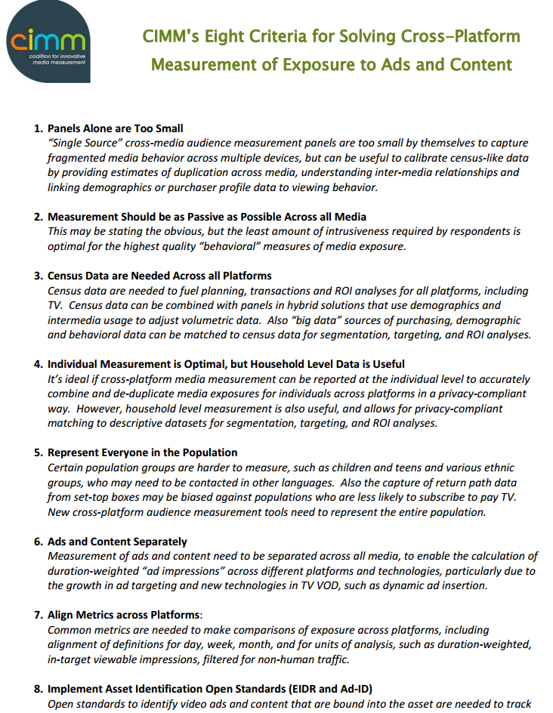
Solving Cross-Platform Measurement: CIMM Describes It Best
comScore solution pillars:
HYBRID
PASSIVE
MASSIVE
PERSON-CENTRIC
HOLISTIC
COMPARABLE
CONTENT & ADS

Slide 3
The comScore Difference
Massive Scale + Smarter Methodology
Better Information

Slide 4
Precision Requires Scale
To measure who consumes what, when, where – and for how long
260M DESKTOP SCREENS
160M MOBILE PHONES
95M TABLET SCREENS
40M TV SCREENS
117M VOD SCREENS
40,000 U.S. MOVIE THEATER SCREENS
1M DIGITAL PANELISTS
70,000 TV PANELISTS
125,000 GLOBAL MOVIE THEATER SCREENS
All numbers are U.S. only, except where noted.
Notes:
-- Stats verified by Autum Molay 2 MAR 2016

Slide 5
Scale Provides Depth
Zero-Cell Completeness, Data Stability, Advanced Demography, Granularity, Local Market Reporting
285+ National Television Networks
2,000+ Local Stations
8.8B VOD Transactions
10M+ Websites
10,000+ Mobile Apps
All numbers are U.S. only.

Slide 6
World’s Largest Single-Source Information Set
This is scale.
10M+ PEOPLE
Directly observed duplication across TV, desktop, smartphone, tablet, OTT with demographics and advanced targets
Understanding your complete audience requires more than simple addition.

Slide 7
\
Only the New Model Powers Granular Insights
Sample-Only Model
Panel-Based Limited Granularity
cS Census Model
Panel-Informed Unprecedented Scale
SCALE ENABLES DEPTH
AUTO INTENDER TULSA, OK
TIDE BUYER
VOD
VOD
DVR
DVR
PC
Mobile
Live TV
Live TV
M18 - 34
PC
Auto Intender
Mobile
In Tulsa, OK
M 18-34
Tide Buyer
50K
20K
10K
500
7M
4M
3M
500k
50K
7K
2K
Scale enables depth
Notes:
Census model numbers based on “single source” unduplicated audience.
Old numbers:
17M+
12M
10M
5M
50K
7K
2K

Slide 8
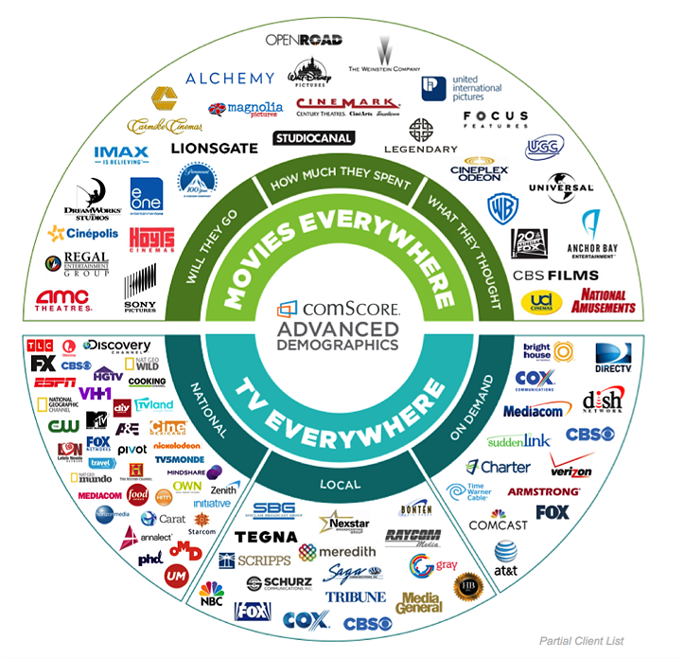
Experience and Market Acceptance Pre Merger Rentrak The New comScore 11 years of experience, 1,200+ clients 3,200+ clients
150+ National Networks
45+ Operators
60+ National Agencies
10+ Political Agencies
630+ Local Stations
120+ Local Agencies
Logos based on pre-merger Rentrak client list.

Slide 9
The comScore Holistic Cross-Platform Solution – Available Today
Audience
Activation
Advertising

