Slide 1
ABC Multiplatform Viewing: Adding it All Up
APRIL 2016
Presented by:
Lisa Heimann
VP, ABC /ABC Studios Multiplatform Research

Slide 2
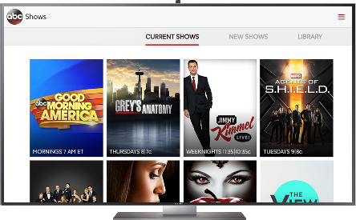
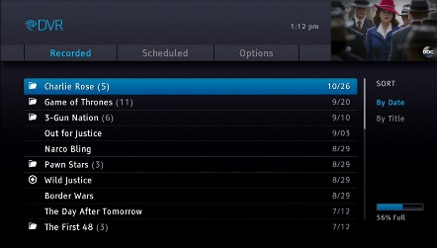
How does Grey’s Anatomy perform across all platforms?
LINEAR TV
SOCIAL
VOD
Greys Anatomy (5)
ONLINE

Slide 3
So many metrics, so little time
GREY’S ANATOMY SEASON PREMIERE – 9/24/15
4.4 Live 7 A1849 Rating
1.7 mil Uniques
800K Unique Set Top Boxes
719 mil Minutes (P2+)
163K Unique Authors
30 mil Impressions
989K Orders
3.0 A18-49 C3 rating
2.2 mil Starts
325K Tweets
Greys Anatomy (5)
22.3 mil Viewers Reached
43 mil Minutes
63% View Through
85 % A18-49
537 VPVH (A18-49)
68% A18-49
15 mil Social Impressions
81 mil Minutes
Sources: Nielsen, Comscore, Rentrak, Freewheel, Omniture, Hulu, Uplynk

Slide 4
How ABC Research calculates multiplatform ratings
For Multiplatform Ratings, we convert minutes viewed with demo comp to A18-49 average audience rating
TOTAL MINUTES
EPISODE DURATION (MINUTES)
ESTIMATED ONLINE/VOD AVERAGE MINUTE RATING
X
AUDIENCE
COMP
=
A18-49 NIELSEN UNIVERSE ESTIMATE
Tracked at an episode level and based on minutes to avoid overstatement or duplication
Metric | Source(s)
VOD Duration – P2+ | Rentrak On Demand Essentials
Online Duration – P2+ | Internal [Uplynk, Hulu & FreeWheel]
Audience Comp By Show (Online) | Nielsen DAR/ ComScore Video Metrix
Audience Comp by Show (VOD 4+) | Nielsen Cross Platform VOD
Co-viewing Factors | Proprietary Study

Slide 5
Representing multiplatform viewership as average minute audience offers a comparable view
GREY’S ANATOMY SEASON PREMIERE (9/24/15) – AVERAGE AUDIENCE
Total Viewers (Mil)
Demo Rating
15,460,000
10.84
5.92
7.38
3/27/05
Series
Premiere
ONLINE & VOD
DAYS 1-7
LIVE+SAME DAY
P2+
A18-49
W18-34
Lift vs.
Live 7
+20%
+35%
+54%
Source: TV based on Nielsen Media Research, Online from Uplynk/Hulu/FreeWheel, VOD Days 4+ from Rentrak.

Slide 6
Sharing ABC Multiplatform Ratings with our advertising clients through the Unified Insights dashboard
www.abcallaccess.com

